Slide 1

Trust and trustworthiness:
Communication in an age of Covid
Dr Alexandra Freeman
@alex_freeman
Winton Centre for Risk and Evidence Communication
WintonCentre@maths.cam.ac.uk
Notes:
A bit of background to me… Slightly unusual perspective. Communication with the public as a media professional, on behalf of institutions, as an academic.

Slide 2
How do people choose what to believe/trust?
How does what people read and believe affect their actual behaviour?
How can information, and organisations, signal trustworthiness?
What does this mean for scientists and the scientific publishing system?
Winton Centre for Risk and Evidence Communication
WintonCentre@maths.cam.ac.uk
Notes:
Roughly going to go through these points… I’ll go as quickly as I can as I expect this talk mainly to raise questions which we can then discuss!

Slide 3
How do people choose what to believe/trust?
Winton Centre for Risk and Evidence Communication
WintonCentre@maths.cam.ac.uk
Notes:
Starting with…
Back in the spring and summer of 2020 we did surveys across multiple countries asking people about covid. One of the questions we asked in 10 of them was about what information about coronavirus they trusted, and why.

Slide 4
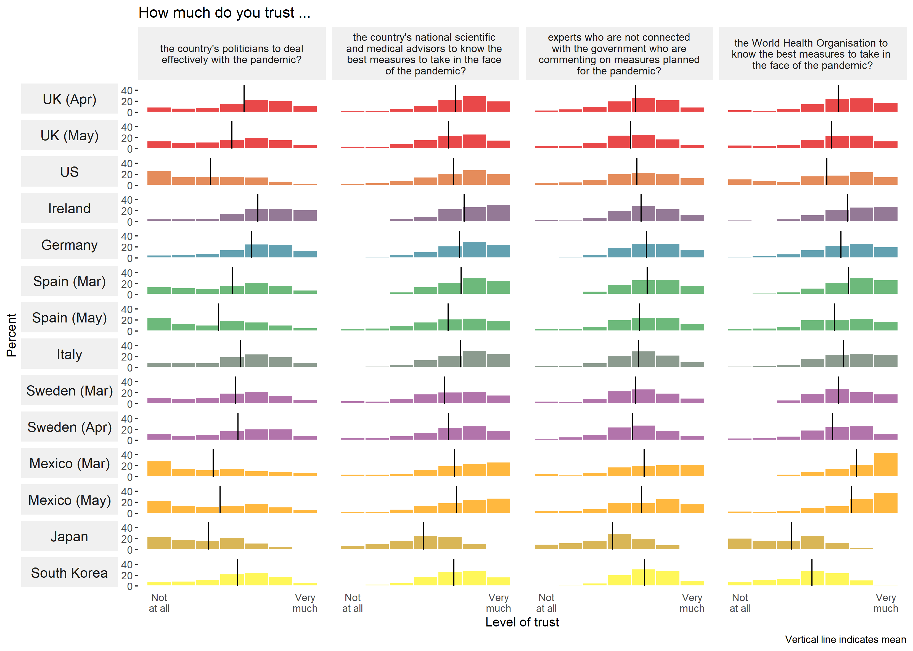
No. Deaths
8958
30,615
75,670
1,032
126
2,696
26,070
6,077
110
1,476
8
2,704
98
208
Winton Centre for Risk and Evidence Communication
WintonCentre@maths.cam.ac.uk
Notes:
Here are some results. I know it’ll take you a while to get used to this kind of plot…. Each line is a different country (or a country at a different timepoint). At the end of the line you can see how amny (few) deaths there were at the time we did the survey. This was early on in the pandemic! And then each coloured caterpillar is how they rated their level of trust in different people from ‘not at all’ on the left to ‘very much’ on the right. The black line shows the average (the mean) rating.
Politicians – scientific advisors – independent experts – WHO
Politicians pretty untrusted in US (this was Trump), Spain, Mexico and Japan!
Japan in fact pretty untrusting of everyone… And to help us understand why, we asked people to tell us WHY they trusted or distrusted each group…

Slide 5


What is going on in Japan?
“Decisions are slow and inadequate.”
“There is no sense of responsibility, no sense of speed. The devices are scarce, too.”
“I hope the Prime Minister dies of a virus.”
“I want them to listen to the voice of the people more seriously or the voice of the scientists.”
“A group of idiots”
“We are thinking too much about economic risks and not taking sufficient measures.”
“I want them to pay cash quickly to people in need..”
“There's a lot of cover-ups.”
Winton Centre for Risk and Evidence Communication
WintonCentre@maths.cam.ac.uk
Notes:
These are genuinely representative…ouch.

Slide 6
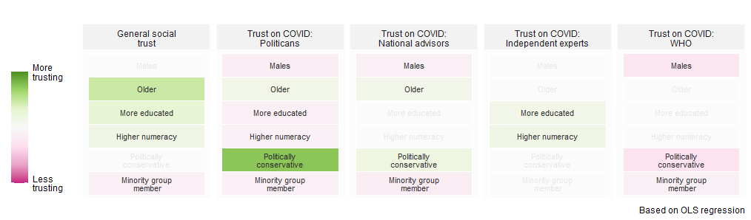
Who trusts whom on COVID in the UK?
Winton Centre for Risk and Evidence Communication
WintonCentre@maths.cam.ac.uk
Notes:
So, looking at the UK in particular, we had a look at the demographics of who was trusting whom on COVID:
Conservatives trusted politicians (we had – have – a Conservative government), and their scientific advisors, and they don’t trust the WHO
Older people have more trust in politicians and their advisors, and have higher levels of general social trust.
Higher education correlates with less trust in politicians and more trust of independent experts and general social trust
Sadly, those who considered themselves to be part of a minority group in the country correlated with lower trust pretty much across the board.

Slide 7
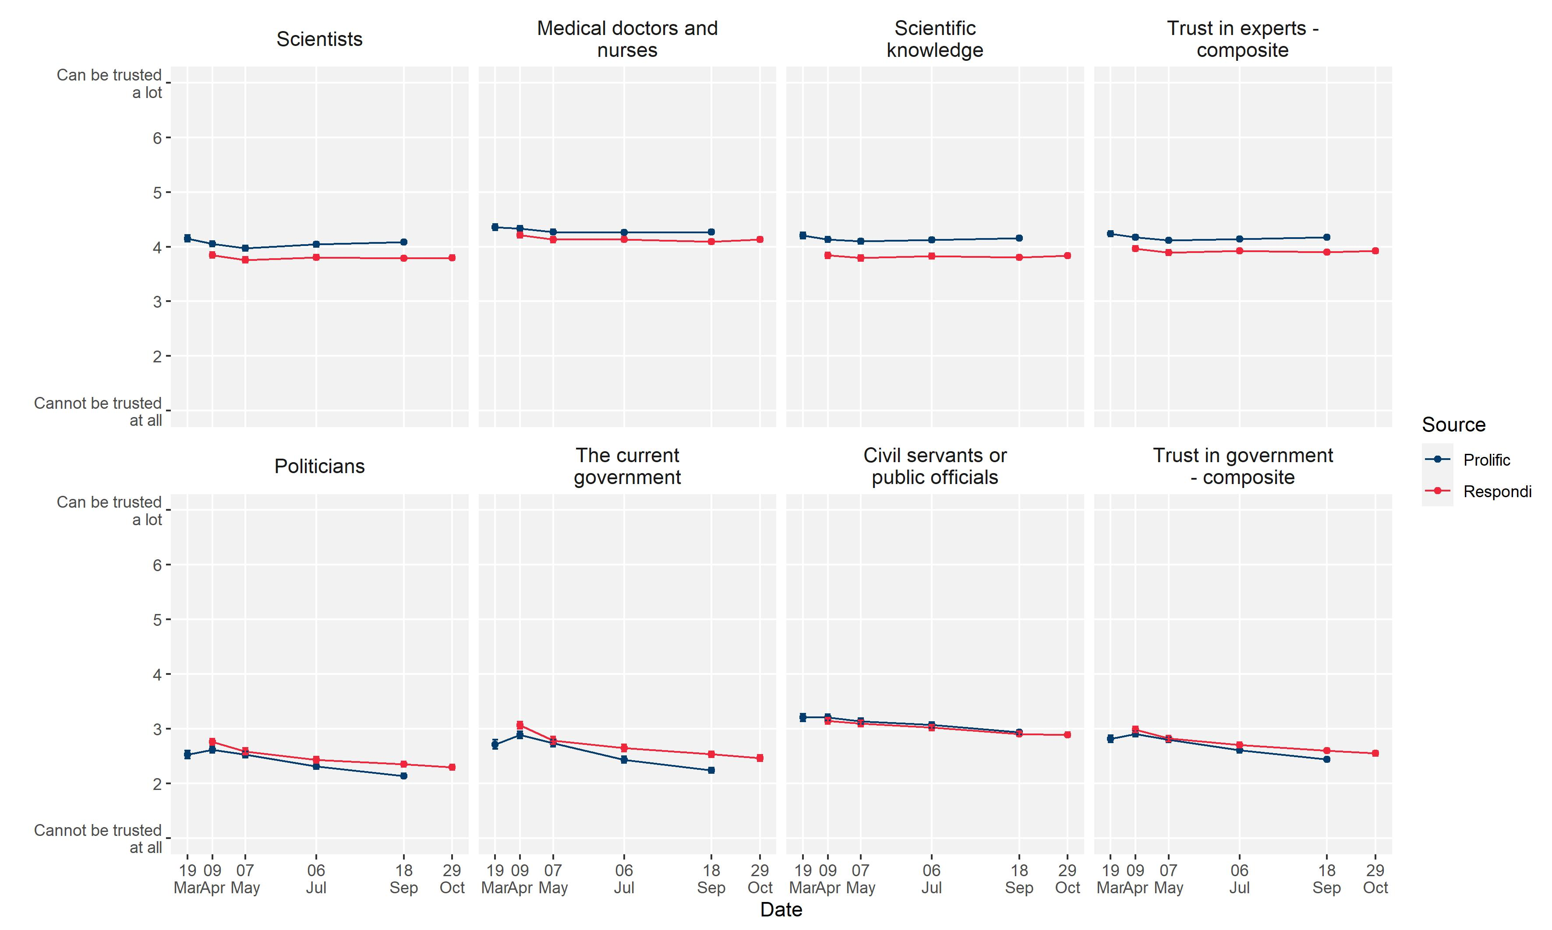
Who trusts whom on COVID in the UK?
Winton Centre for Risk and Evidence Communication
WintonCentre@maths.cam.ac.uk
Notes:
And looking across 2020, from the start of the pandemic, in the UK we have seen trust in scientists, scientific knowledge, and medical professionals hold pretty steady (and relatively high).
Trust in politicians, the current government and public officials decreased through the year.

Slide 8
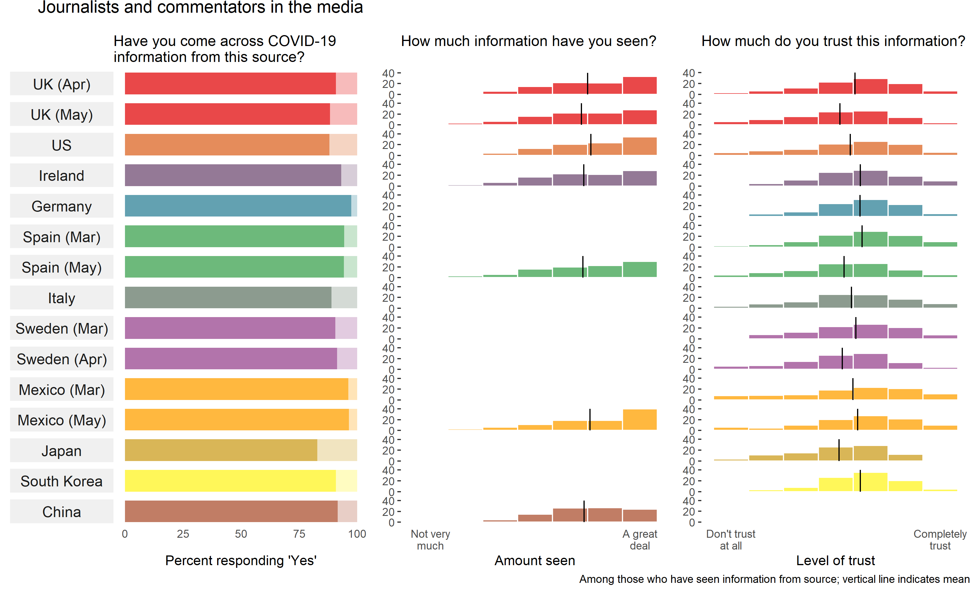
Winton Centre for Risk and Evidence Communication
WintonCentre@maths.cam.ac.uk
Notes:
So, then, we also asked people how much they trusted information on covid that they’d seen in different media.
Not too much range on trust, though Spain, the UK and Sweden all saw a bit of a fall in trust in journalists between surveys. This echoes a bit of sentiment change we’ve seen in several countries, where there was a peak in the first few weeks of the pandemic in trust and prosociality and then a drop-off.

Slide 9

“I try to read impartial news sources ”
“For a subject as serious as this I trust lies would be removed”
“Scaremongering”
“they sell news, not truth”
“Journalists are inevitably lying, self-serving, scum”
Winton Centre for Risk and Evidence Communication
WintonCentre@maths.cam.ac.uk
Notes:
How do people judge what to trust?
In the UK, the SOURCE of the information was paramount to how much people trusted it – and the perceived motives of journalists were very prominent, usually that they had stories to sell and so were keen to hype.
Even some of the positive ones were sometimes tinged that they only trusted them because of regulation or because of the seriousness of the topic.

Slide 10
“It is consistent with all the information I have come across”
“There is so much conflicting information”
Winton Centre for Risk and Evidence Communication
WintonCentre@maths.cam.ac.uk
Notes:
There were comments on the consistency of information – and these were a bit more about consistency between sources rather than consistency with experience or beliefs (the ‘common sense’) compared with the posters.

Slide 11
“Usually they have more official/scientific evidence for what they're reporting”
“Journalists made spurious claims and assumptions without reference to scientific facts.”
Winton Centre for Risk and Evidence Communication
WintonCentre@maths.cam.ac.uk
Notes:
And a reasonable number of people assessing the information on the quality of the evidence, as they perceived it, behind the claims/information.

Slide 12
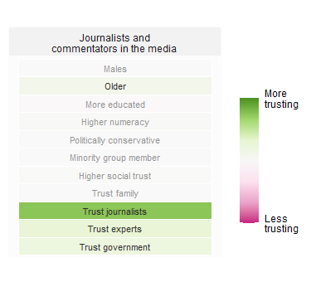
Who trusts journalist and traditional media?
Who trusts information from the media in the UK?
Winton Centre for Risk and Evidence Communication
WintonCentre@maths.cam.ac.uk
Notes:
Probably as you’d expect – older people, those with higher trust in journalists and experts and higher trust in government.

Slide 13
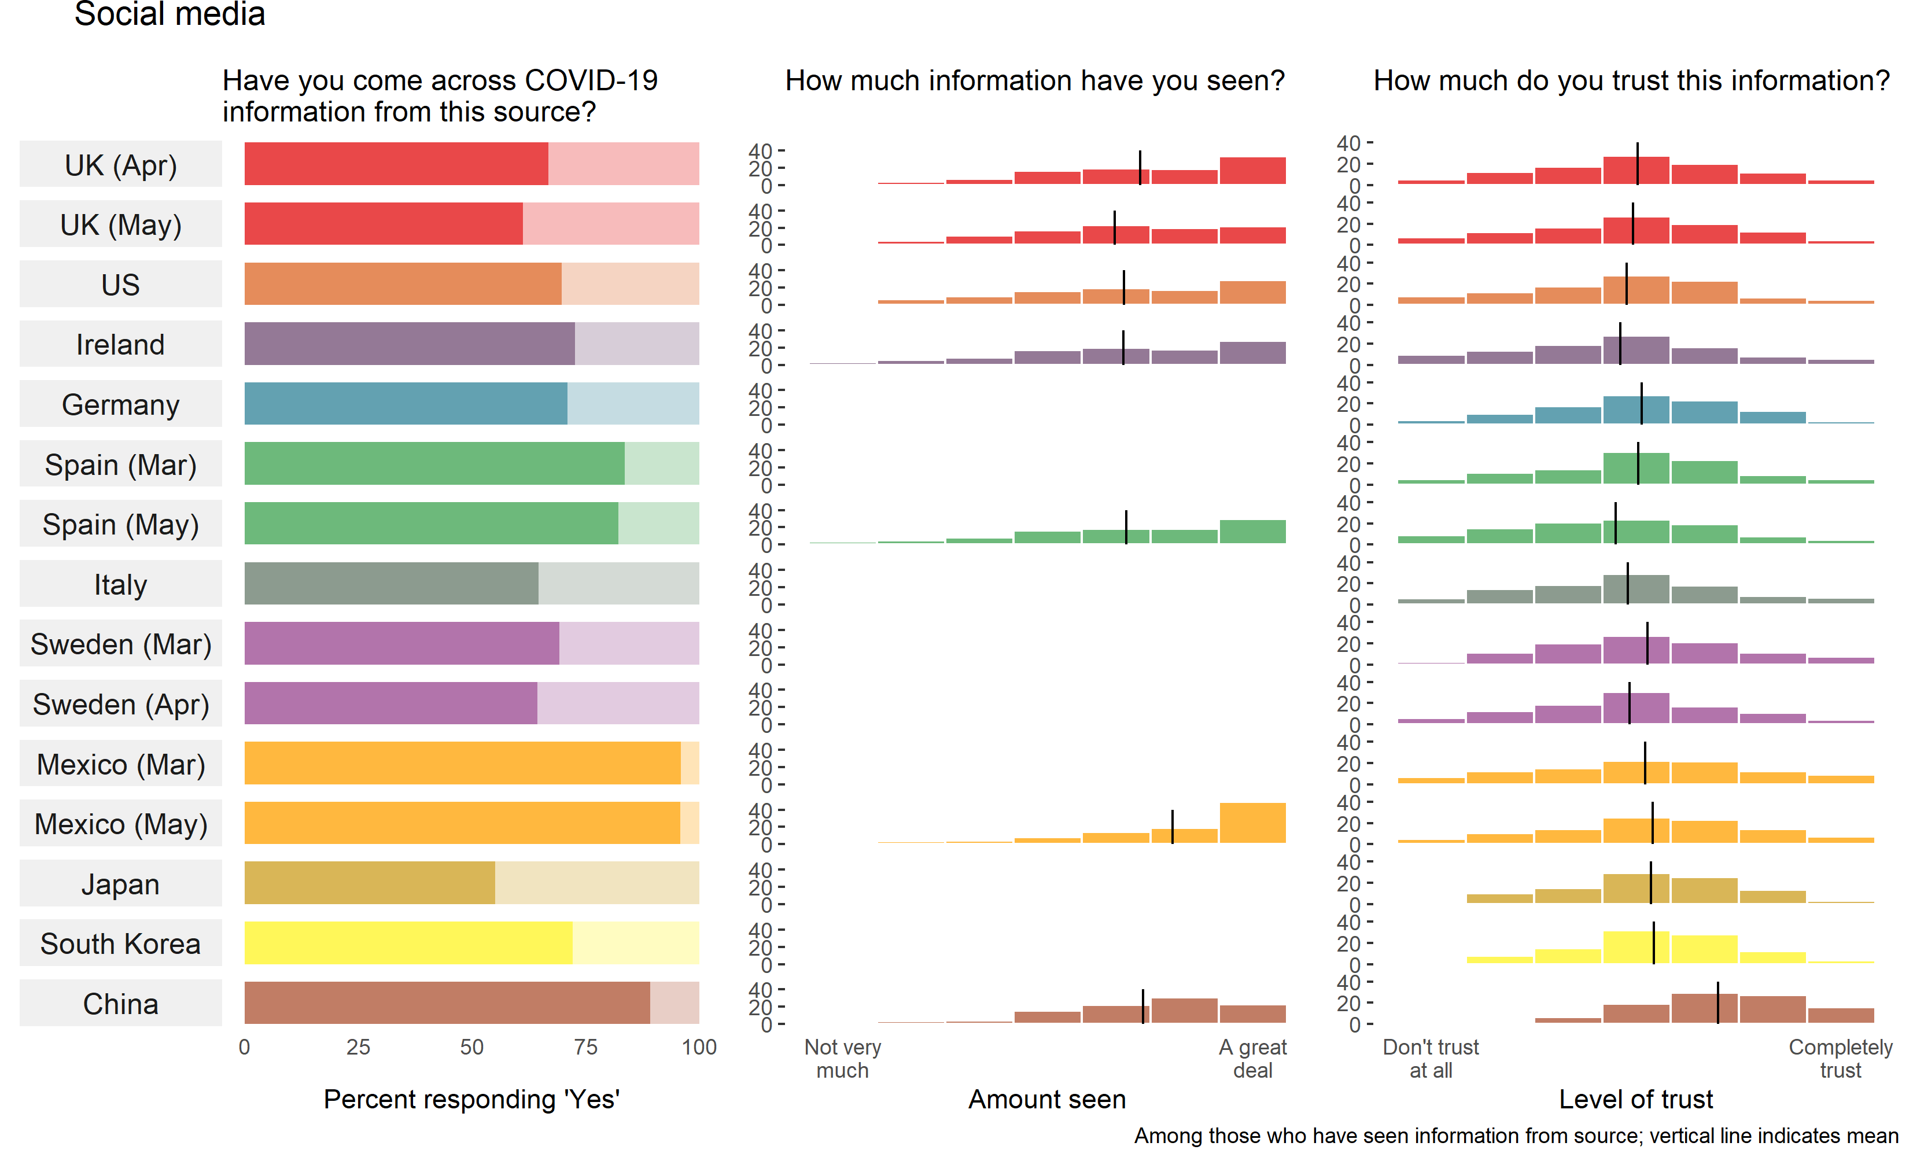
Winton Centre for Risk and Evidence Communication
WintonCentre@maths.cam.ac.uk
Notes:
Briefly – social media, which you might see as a contrast…
Perhaps surprisingly high trust in China?

Slide 14
Why do people trust social
media in China?
“Irresponsible fabrication of news”
“It's not official, there's speculation, there's rumors.”
“Now social networks are full of fake news in order to gain click-through rates without a bottom line.”
“Information that has not been verified needs to be carefully analyzed.”
“The web is not an extralegal place, and messages posted on social media are responsible and mostly credible.”
“Trust the government.”
“Most of it is based on official information.”
“Believe in the country, support the country, cooperate with the country.”
Winton Centre for Risk and Evidence Communication
WintonCentre@maths.cam.ac.uk
Notes:
Well here are some comments.
The top are negative comments and very similar to the type I saw from other countries.
Along the bottom, though, are some representative positive comments. It’s clear that a lot of what they are seeing on social media is officially produced and they trust that. And they think the regulation is good. There were quite a few patriotic messages like that in the bottom left too.

Slide 15
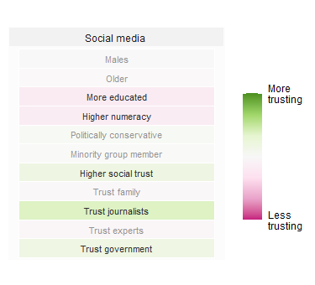
Who trusts social media?
Who trusts information from government sources in the UK?
Winton Centre for Risk and Evidence Communication
WintonCentre@maths.cam.ac.uk
Notes:
People with lower education and lower numeracy, those with high social trust, trust in journalists and trust in the government…

Slide 16
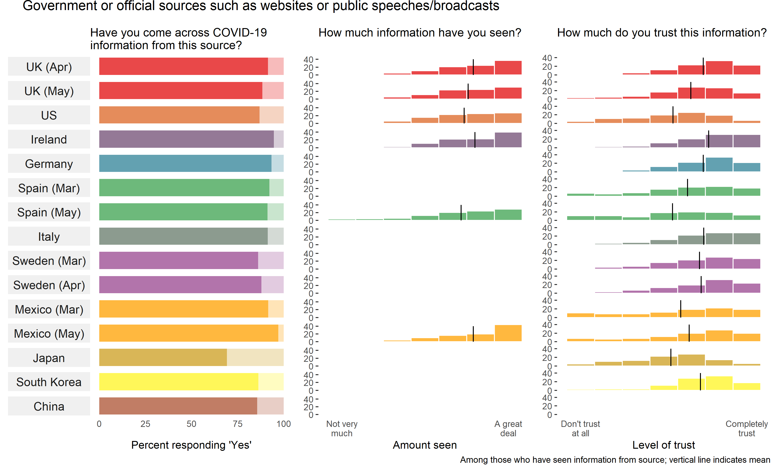
Winton Centre for Risk and Evidence Communication
WintonCentre@maths.cam.ac.uk
Notes:
Finally, trust in government/official sources (other than posters). Much more variation between countries here, as you might expect. Low in the US, Spain and Japan, in line with what we saw earlier.

Slide 17
“I believe the Govt are being guided by scientists and genuinely care about the population”
“’Cause they don’t want to panic people so might hide some information”
Winton Centre for Risk and Evidence Communication
WintonCentre@maths.cam.ac.uk
Notes:
And why?
Here again there was a lot about the source and the perceived motives of the government. A lot said that they thought the government was trying not to cause panic – and some rated that as positive and some negative. Actually out of the positive ratings – quite a lot mentioned the fact that it seemed to be coming from scientific advisors. Again, remember that this is March 2020’s data. It may well have changed recently with more coverage of divergent scientific opinions.

Slide 18
“I trust that the information given has scientific grounding.”
“We don't know the infection rate as not all people with symptoms are tested.”
Winton Centre for Risk and Evidence Communication
WintonCentre@maths.cam.ac.uk
Notes:
The information consistency quotes were similar to those about the media, so skipping to the quality of evidence comments, these were the kinds of positive and negative comments.

Slide 19
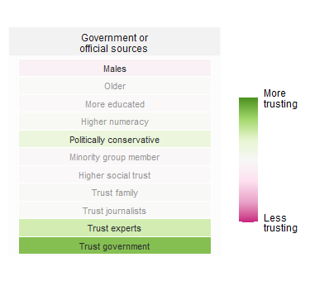
Who trusts government and official sources?
Who trusts information from government sources in the UK?
Winton Centre for Risk and Evidence Communication
WintonCentre@maths.cam.ac.uk
Notes:
Probably as you’d expect again – Conservatives, and those who trust experts and government… and women (maybe less expected).

Slide 20
Summary – how do people seem to judge trustworthiness of COVID info?
Assessing the source
  Perceived motives (eg. ‘they’re trying to prevent panic’) and
  conflicts of interest (eg. ‘they’re self-serving’)
  Perceived expertise (eg. ‘they have access to the top scientists’) and
      access to information (eg. ‘they have the latest data’ or ‘it’s personal experience’)
Assessing the information
  Consistency with other information (eg. ‘other people say the same thing’)
  own beliefs (eg. ‘it sounds plausible’)
  personal experience (eg. ‘I’ve seen it myself’)
  Perceived completeness (eg. ‘I think they’re not telling the whole story’) and
      detail (eg. ‘it’s a bit vague’)
Winton Centre for Risk and Evidence Communication
WintonCentre@maths.cam.ac.uk
Notes:
So this is a summary of what I feel comes out of the comments that people made in the survey.

Slide 21
How does what people read and believe affect their actual behaviour?
Winton Centre for Risk and Evidence Communication
WintonCentre@maths.cam.ac.uk
Notes:
Quickly, then, we also have evidence on the link between trust in information and people’s behaviour…

Slide 22
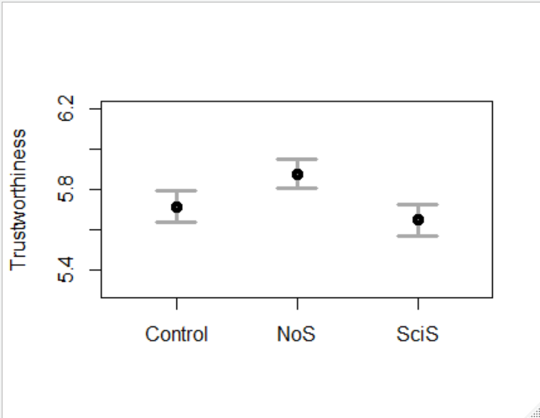
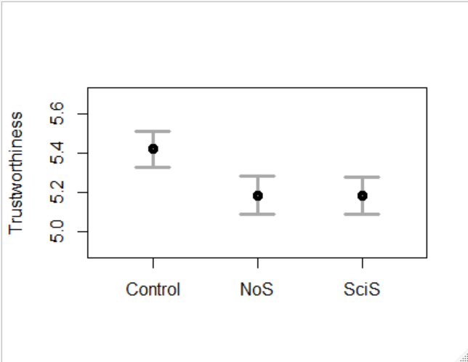
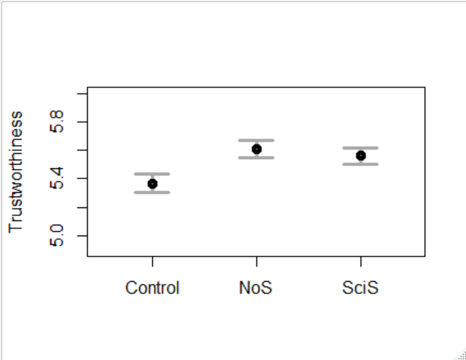
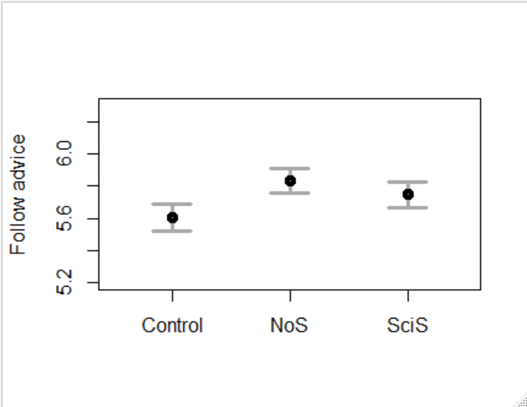
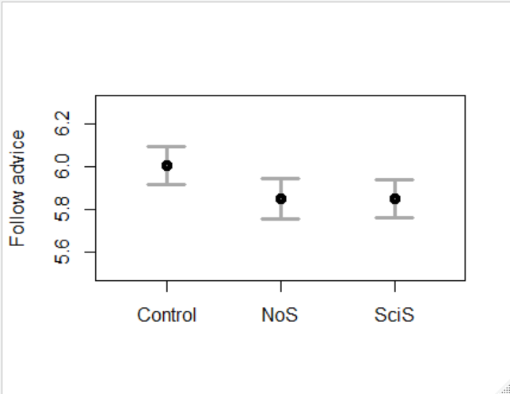
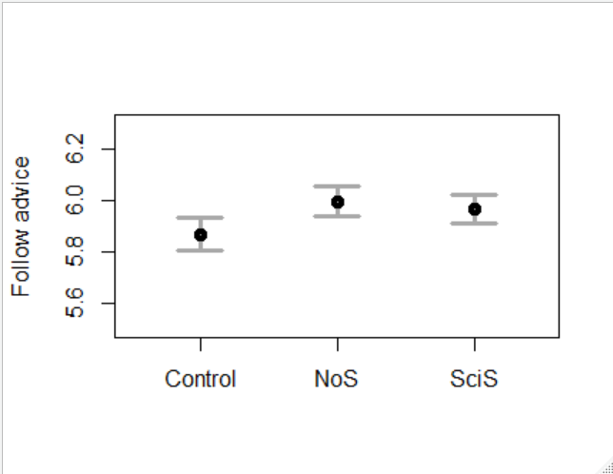
Perceived trustworthiness of advice (whatever it is):
…is always closely mirrored by people’s rated likelihood of following it:
Winton Centre for Risk and Evidence Communication
WintonCentre@maths.cam.ac.uk
Notes:
We get evidence of the strength of this link in every experiment we do about communication.
It doesn’t matter what the advice was in each of these experiments, what you can see if how the trustworthiness and the rating of how likely they are to follow the advice match.

Slide 23
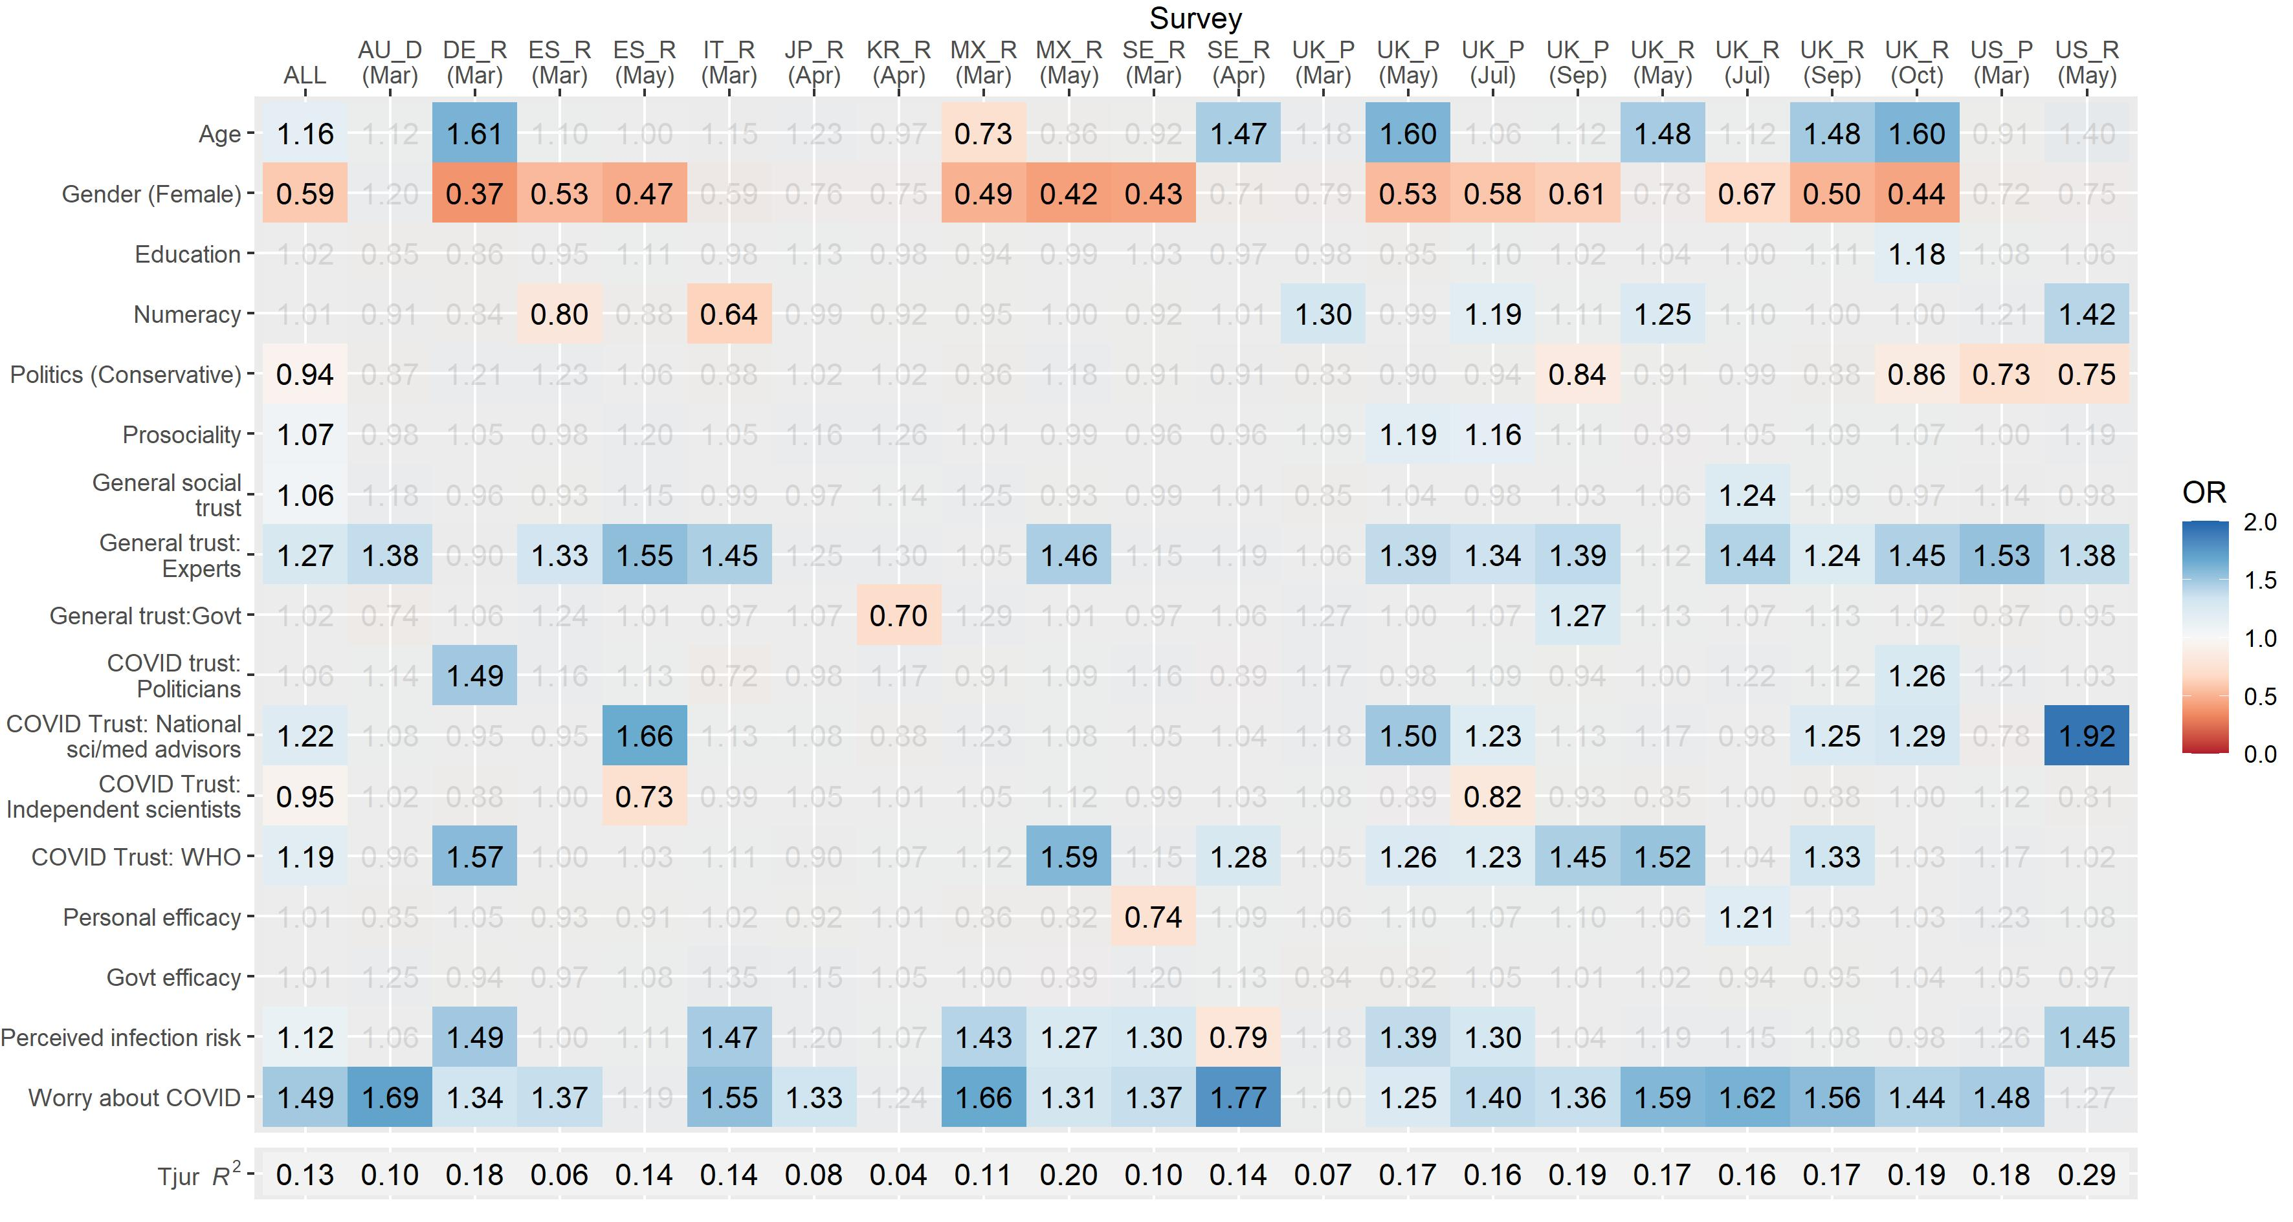
What factors affect people’s willingness to take the covid-19 vaccines?
Being older
Being male
Trust in scientific experts/expertise
Trust in National scientific advisors
Trust in WHO
Perceived risk of infection
Worry about COVID-19
Winton Centre for Risk and Evidence Communication
WintonCentre@maths.cam.ac.uk
Notes:
Again, the details of this table don’t matter – it shows in colour the factors that most strongly played into people’s decisions about covid vaccines across different countries. You can see how important trust is, across countries.

Slide 24
How can information, and organisations, signal trustworthiness?
Winton Centre for Risk and Evidence Communication
WintonCentre@maths.cam.ac.uk
Notes:
So – everyone tends to ask ‘how can I be trusted’. And our answer is always – ‘be trustworthy’!

Slide 25
Baroness Onora-O’Neill
A trustworthy organization demonstrates:
  Honesty
  Competence
  Reliability
Winton Centre for Risk and Evidence Communication
WintonCentre@maths.cam.ac.uk
Notes:
Philosopher Onora O’Neill has long talked about the key aspects of demonstrating trustworthiness and I’d highly recommend her 10 minute TED talk on the subject.
She outlines three key things that trustworthy communicators demonstrate.

Slide 26
Our findings suggest something similar…
Honesty
  Be open and clear about your motives
  conflicts of interest
  uncertainties
  Perceived expertise
  access to information
Competence
Reliability
  Consistency with other information
  People judge things as reliable according to their own beliefs and personal experience so causal explanations
  for advice can help plausibility.
  People look out for detail and completeness as cues of reliability
In addition…
Winton Centre for Risk and Evidence Communication
WintonCentre@maths.cam.ac.uk
Notes:
Which I think fit quite neatly with our findings around COVID and so produce a bit of a ‘hit list’ for communicators.
So I want to end up talking about what this means for scientists and scientific communicators…

Slide 27

Inform vs Persuade
Informed consent
Marketing
Public health? Science advisor?
Winton Centre for Risk and Evidence Communication
WintonCentre@maths.cam.ac.uk
Notes:
Firstly, think about your motivations when you are communicating: where do you fall on a spectrum from ‘informing’ to ‘persuading’?
At the two extremes you have pure informed consent in medicine…. Or pure marketing and PR. Where do government science advisors sit? Or public health professionals? Or journalists?

Slide 28
Inform vs Persuade
Understand vs Believe
Better informed vs Changed behaviour
Information vs A message
Be trustworthy vs Be trusted
Winton Centre for Risk and Evidence Communication
WintonCentre@maths.cam.ac.uk
Notes:
The aims at the two ends of that spectrum are quite different, and it will change the perspective on a lot of aspects of your communication.
Do you want people to understand the information, or does it matter more that they just believe it?
Do you want them to be better informed or to change their behaviour?
It’s much harder to measure the aims of informative communication! If your aim is to ‘get a message across’ or change behaviour then you can more easily measure the number of people who did a particular thing or say they believe a particular thing.
It’s quite a different way of thinking, and I think science professionals in particular have to think hard about where they sit when they are communicating.
This is where I move into some thoughts about scientific dissemination.

Slide 29
The communication pipeline
Academic/industry
scientific research
Scientific
publications
Traditional and
online media
Individual
members of
public
Press offices /
comms depts
Government Depts /
NGOs etc
Commissioned
analytic and
survey research
Policy makers
Winton Centre for Risk and Evidence Communication
WintonCentre@maths.cam.ac.uk
Notes:
Let’s have a quick look at how scientific results are disseminated…
And then think about how sensitive to motivations people’s feelings of trust are.

Slide 30
The communication pipeline
Maximise number of papers/readers
What are the incentives?
Academic/industry
scientific research
Maximise number of
readers
Scientific
publications
Maximise number of
readers
Maximise number of
readers
Press offices /
comms depts
Traditional and
online media
Individual
members of
Public (voter)
Government Depts /
NGOs etc
Commissioned
analytic and
Survey research
Keep ministers/voters happy
Policy makers
Keep clients happy
Maximise number of voters
Winton Centre for Risk and Evidence Communication
WintonCentre@maths.cam.ac.uk
Notes:
And then look at the incentive structure that drives each of those steps…
The main thing that the top line is trying to get is ATTENTION
The main thing that the bottom line is trying to get is ‘keeping people happy’
Both of these are driving the use of SPIN + communication for persuasion not information.
Just to emphasise, this is not just a problem with the media….

Slide 31
Winton Centre for Risk and Evidence Communication
WintonCentre@maths.cam.ac.uk
Notes:
Academics are equally guilty of persuasion when they write papers, as this study shows…

Slide 32
Actual evidence for causality in data
Very low
Low
Moderate
High/v high
Notes:
They looked at the 50 top-reported studies over a period of time.
This was how causal the data actually was…

Slide 33
Actual evidence for causality in data
Very low
Low
Moderate
High/v high
Strength of causal language in paper
Weak
Moderate
Strong
Notes:
And this was how causal the language was in the papers reporting the data:
From 30% excusable causality to 50%...

Slide 34
Actual evidence for causality in data
Very low
Low
Moderate
High/v high
Strength of causal language in paper
Weak
Moderate
Strong
Strength of causal language in media
Notes:
The media did take that another step further – from 50% up to 83% causal language. But it starts with the academic publishing and I bet you a lot of the next jump was made in the press release. You must be responsible for your press releases!
And that’s where I think this issue goes right back to the way we disseminate scientific findings in the first place…

Slide 35
What does this mean for scientists and the scientific publishing system?
Winton Centre for Risk and Evidence Communication
WintonCentre@maths.cam.ac.uk
Notes:
So if you’ll bear with me for a couple more minutes…. Separate to my work in Cambridge, I’m trying to change the scientific publishing system.
I actually think that the Covid pandemic has brought a lot of the problems of the current system to public attention (like the speed, issues with peer review etc)

Slide 36

What’s wrong with the current system?
Journals are trying to do two jobs at once:
Notes:
On top of all of those problems, I think there is a lot stemming from one principle issue: that journals are being pulled in different directions.

Slide 37
What’s wrong with the current system?
Journals are trying to do two jobs at once:
Disseminating useful findings to practitioners and researchers
(mainly persuasion)
Notes:
Dissemination is a really important one, and the one that drives their revenue, really. Think of the most ‘popular’ bits of journals – it’s news and views…
The aim for things to be attractive and readable drives things like word counts, publication bias, a lot of the QRPs…

Slide 38
What’s wrong with the current system?
Journals are trying to do two jobs at once:
Disseminating useful findings to practitioners and researchers
(mainly persuasion)
Being the primary research record: what has been done, by whom, when and with what result, in full detail
(pure information)
Notes:
But at the same time they’re being forced to fulfill another job – a rather thankless one. Being a kind of ‘patent office’ for establishing priority and a place to record full details of methods, data etc. That’s a very specialized thing and is being naturally sacrificed as it bends towards serving the first.

Slide 39

What can we do?
Split the two jobs
Notes:
So I think the answer is to split these two jobs….
And that’s what the new system, called Octopus, is. It’s designed to be the new primary research record. To take on the second job, leaving journals free to do the first properly. Then we don’t have the incentives of good dissemination bending the incentives of good research.

Slide 40
A new ‘primary research record’
digital-first,
free to read; free to write,
with automatic language translation.
Not based around papers
but smaller publication units, in a new structure
Notes:
So, Octopus is designed to maximise access to primary research, but also designed to set a new incentive structure to support good science.
Key to that is breaking up the concept of the ‘paper’ as the main unit of publication.

Slide 41

Notes:
The scientific process naturally comes in a series of steps, one after the other. Each step requires quite different skills, and resources.
Forcing people to get right to the end of this process before sharing any of it is causing so many problems. Retrospectively forcing a linear narrative… Only being able to publish when data ‘supports’ the hypothesis… to make a good, readable – persuasive - story.

Slide 42
Notes:
Instead, in a primary research record free of those dissemination incentives, we can allow a structure of publication that more closely matches the actual process…
If you’re familiar with registered reports, it’s a bit like taking that concept to its ultimate conclusion.

Slide 43
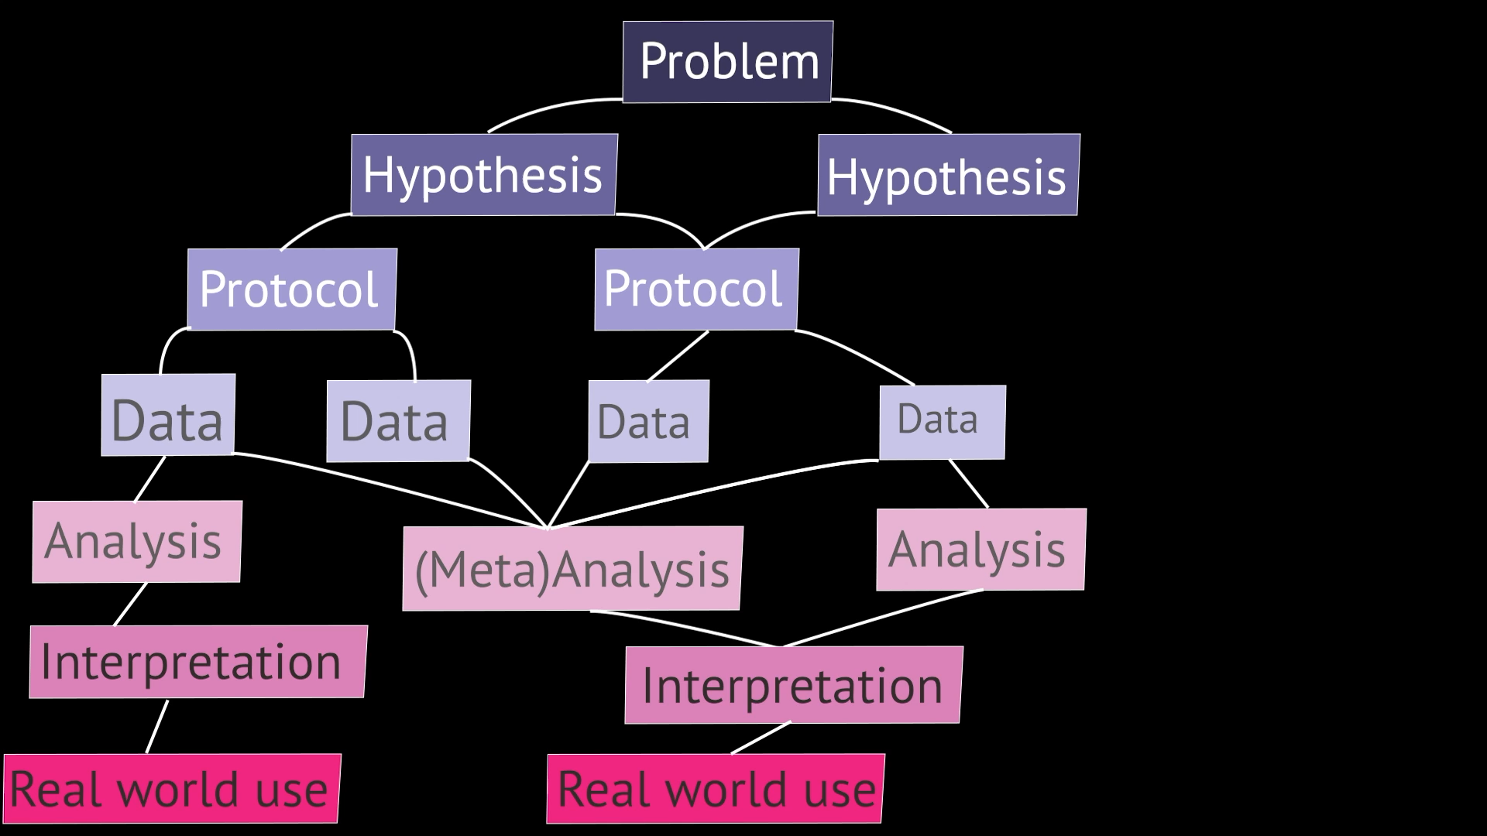
Notes:
And with an eighth type of publication: a review.
Reviews can be published attached to any other kind of publication. And they are treated and valued in the same way as other publications. Because reviewing is a scientific skill just like any other. And by incentivizing it, we can encourage good reviewing.

Slide 44




https://octopuspublishing.org
@science_octopus
Notes:
And thanks to funding from the UK’s government funder UKRI, Octopus is launching next spring.
So, at that point I’d definitely better stop – because I know that we’ve got a really fascinating panel of people with lots to talk about! I just hope this has provided some background for that discussion!

