Slide 1
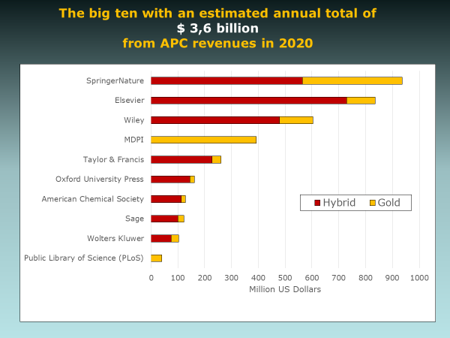
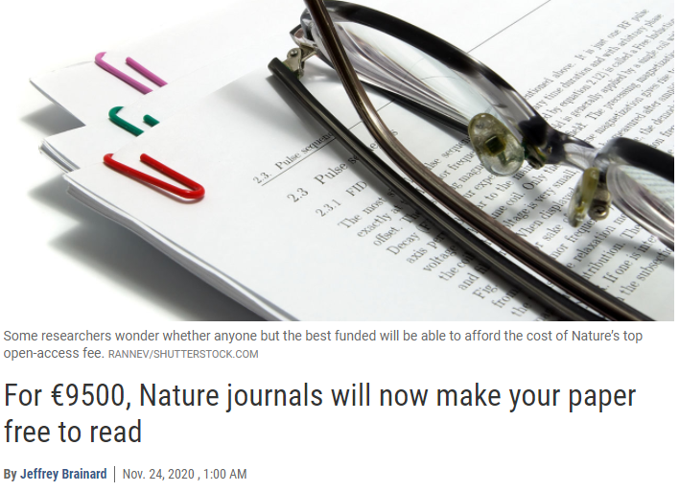
Open Access is already here – with outcomes as expected?
PUBMET conference 2021
Gunnar Sivertsen
Nordic Institute for Studies in Innovation, Research and Education, Oslo, Norway

Slide 2
Outline
Initial observations from Norway and Finland
Big publishers and their global revenues from APC in
Gold OA
Hybrid OA
The global takeover of APC:
Observations
Implications

Slide 3
Main publishers of Gold OA articles from Norway

Slide 4
Main publishers of Gold OA articles from Finland

Slide 5
Main publishers of Gold OA articles from Norway
Now controlled by SpringerNature
Also:
Wiley now controls Hindawi
Taylor & Francis now controls Dove
Elsevier now controls KeAi
De Gruyter now controls Sciendo

Slide 6
APC market shares from the perspective of Finland

Slide 7
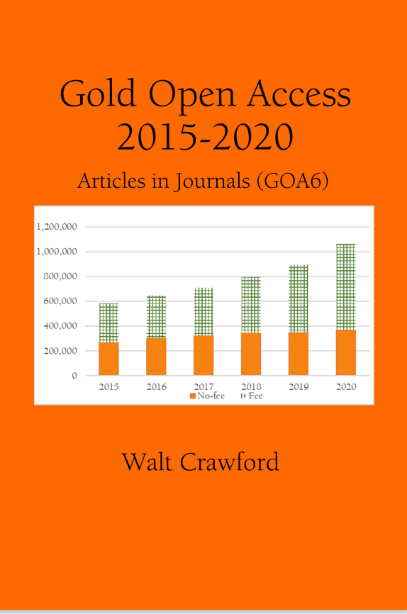
Global APC revenues from journals in DOAJ have tripled in five years, reaching $ 1,3 billion in 2020

Slide 8
Nine big publishers have gradually taken over. They received 85 percent of the $ 1,3 billion in 2020
SpringerNature
MDPI
Wiley
Elsevier
Taylor & Francis
PLOS
IEEE
Oxford UP
Sage

Slide 9
Estimating APC revenues from hybrid journals
I collected the current APC prices from the webpages of 29 major international publishers, publishing almost 12,000 journals
I noticed that
Almost all journals are hybrid now, if not gold.
All publishers are actively marketing the pay-to-be-open option and ‘publish and read’ agreements on top of subscriptions

Slide 10
Estimating APC revenues from hybrid journals
The total numbers of research articles in 2020 were retrieved from Web of Science and Scopus
Assumptions:
Half of all articles in hybrid journals were paid to be open in 2020
All articles in gold journals demanding APC were paid to be open in 2020

Slide 11
The big ten received an estimated annual total of $ 3,6 billion from APC revenues in 2020

Slide 12
Annual revenues of $ 3,6 Billion represent …
Twice the budget of ERC in the same year
Three times the budget of UNESCO in the same year
Almost half of the funds raised by WFP for the same year
The World Food Programme (WFP) saved and changed the lives of more than 115 million people in more than 80 countries in the same year.

Slide 13
The big ten are increasing the annual volumes of articles in their journals

Slide 14
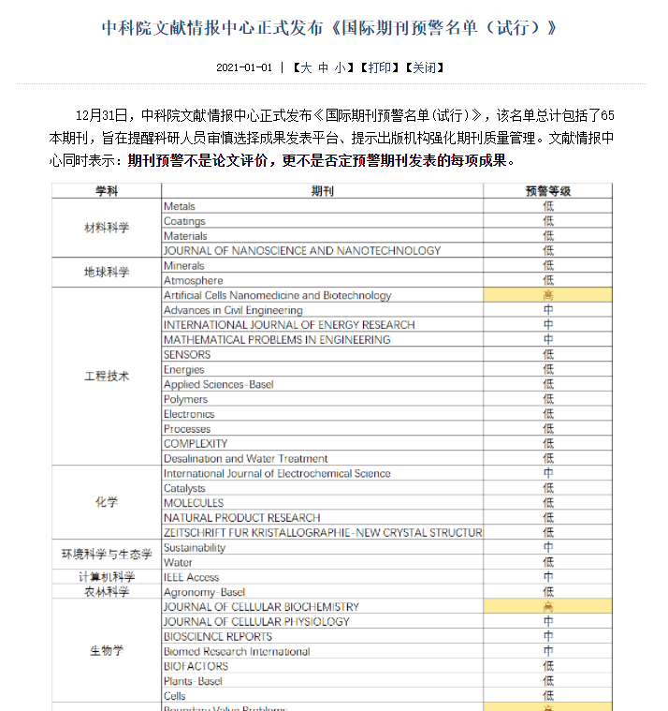
Worries about research integrity
The Chinese Academy of Sciences released an “Early Warning List” of 65 questionable journals at the end of 2020.
The list is a pilot project to follow up a policy to advance research integrity announced by the State Council in 2018:
“Academic journals that neglect academic quality, show disorderly management, or put commercial interests first will be blacklisted.”

Slide 15
Worries about lost revenues
The same 65 journals received a total of $ 100 million in APC from China in 2020.
The share of submissions from China is now decreasing.
Western publishers should be worried according to their analyst: The warning list shows that the Chinese market can be risky. Seemingly healthy revenue streams can come under threat with little warning and unclear justification. (Christos Petrou in Scholarly Kitchen, April 2021)
China’s papers and their shares in 65 journals until August 31, 2021.
Zhang, L., Wei, Y. H., Huang, Y., & Sivertsen G. (2021). What makes a journal questionable? An analysis using China’s early-warning list. Under review.

Slide 16
Observations
The transition to OA is consolidating the market control and increasing the profits of the largest journal publishers
Installing payment on the same side as the pressure to publish makes publishers compete for volume rather than the quality of editorial procedures and contents
Increasing worries in research communities about the quality of editorial procedures and contents
New types of conflicts between publishers and the editors and editorial boards of their journals.

Slide 17
Implications
There is need to support the research communities in defending editorial autonomy and securing research quality in journals.
Listing “predatory” or “questionable” journals has already proved vulnerable to attacks from the business.
We need to reintroduce the notion of recommendable journals and empower our own judgement.
The widespread use of APC calls for well-organized journal evaluation performed independently by the international research communities.

Slide 18
Questions for discussion
Is APC a paywall to perform research? How can we maintain equity, diversity and inclusion in research?
How can OA be promoted without APC? Do we need new journals? Or is it possible to make the commercial publishers compete to serve the journals, not to own them?
If where and how much you publish is a matter of how much you can afford to pay, how should this be reflected in responsible research evaluation?
How to deal with questionable journal practices:
Change peer review – and the transparency of editorial processes?
Establish independent journal evaluation listing recommendable journals?

