Slide 1
Effective Science Engagement and Media
Jadranka Jezeršek Turnes, Kontekst Consulting

Slide 2
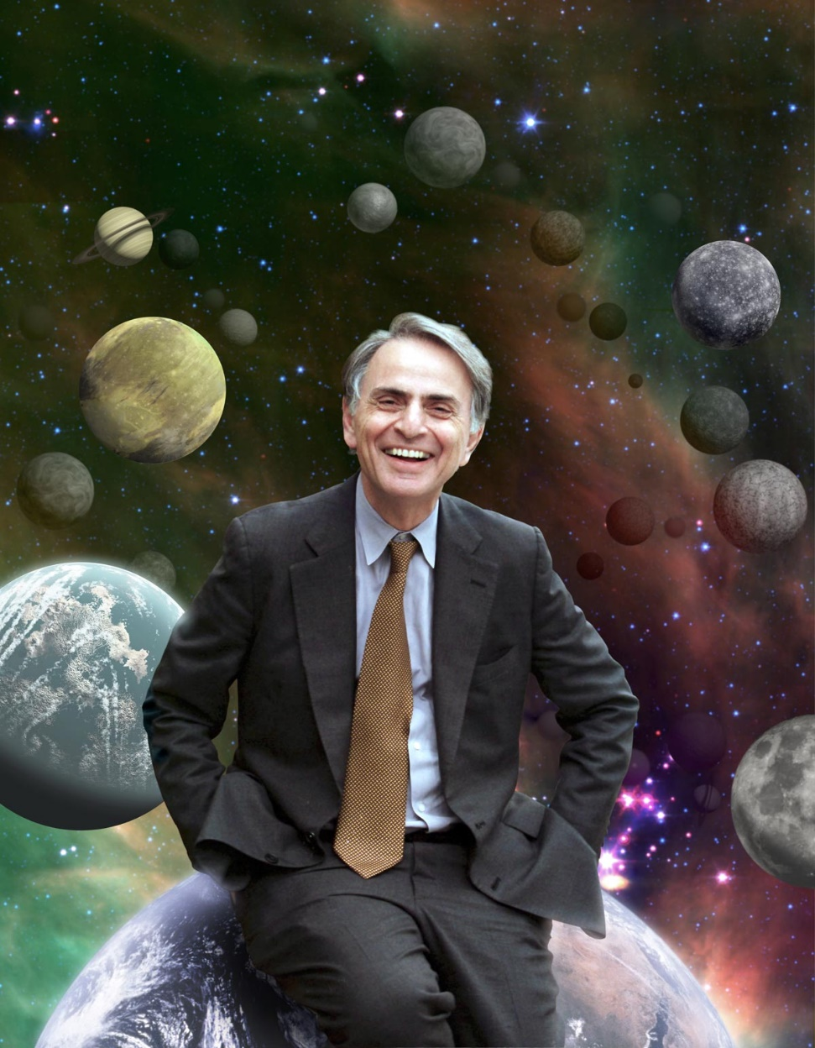

Slide 3
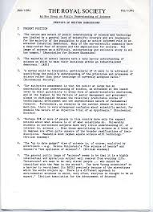
Bodmer Report, 1985
Sir Walter Bodmer

Slide 4
And now?

Slide 5
Why researchers need sci comm competences?
Notes:
Zaupanje
Dialog
Transparentnost
Javni denar
Poslanstvo
Dani schetman – vsak raziskovalec bi moral znati os svojem delu povedati laični javnosti

Slide 6
A new job to learn
Visibility, consensus, trust
Dialogue with society, policy makers, business, peers, future researchers,..
But,
- do they know how to do it?
do RI have strategies for implementation?
do RI know how to engage with a dialogue when there is a risk?
can RI deal with pseudoscience? How?

Slide 8
Please participate…
Which research institute is my role model in communicating their science? Why?
How they communicate to or with me?
How do I get their message?

Slide 9
Research Institute / Organisation
Projects / Teams
Issues /
Ad Hoc
Responsability
Reputation
Impact

Slide 10
How to progress sci comm in RI?

Slide 11
Why?
Scientific excellence. Rankings
Getting more resources
Future - young researchers
Advocacy
Collaboration
Reputation
Influence
Business
Engagement

Slide 12
Engagement!
Communication
Going forward, be proud
Telling stories about the science
Justifying the spenditures
Making meaning
Prooving. Facts!
To be listened
Avoiding pseudoscience
This is what scinece and research institutions has to tell about itself.

Slide 13
Science to Come Out of ....its Ivory Tower
Storytelling?
Emotions?
Presentation?
Facilitation? Moderation?

Slide 14
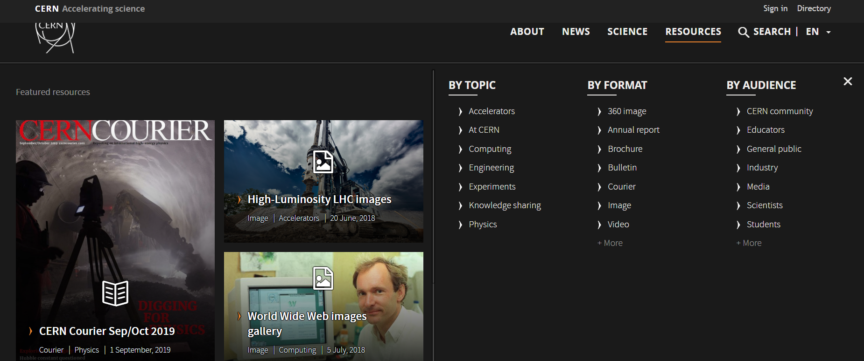

Slide 15
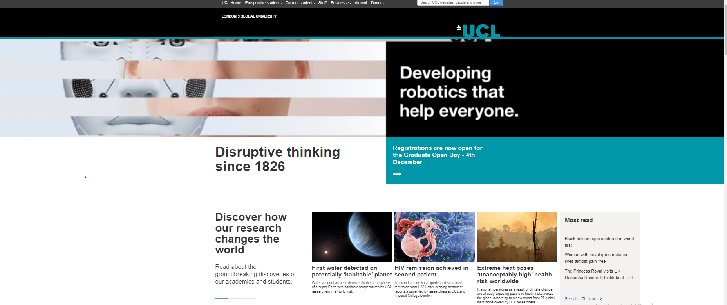

Slide 16
Key words: - impact (results) - knowldege (jobs, work) - mission (better society)
Does this resonate with me?

Slide 17
Structure: regular communication and/ or a specific reason
Corporate/ Institutional
Reputation
Strategy
Projects
EU
Local
Issue
Ad hoc
Crisis
Regular
Applied science
Awards

Slide 18
Science Engagement: competence of RI
RI Corporate / Institutional
Reputation
Strategy
Projects
Issue
Regular

Slide 19
RI: Institutional communication strategy
Strategic support
Proactive - goals
Building reputation
Embracing internal and external activities
Regular events/ editions
Communicating regular key events
Important engagement for internal audience
Long term – yearly plans

Slide 20
Who is (your) target audience?
Lay public
Media
Peers
Regulators
Financers
International (EU, global)
Local community

Slide 21
Audience - Purpose of your presentation
Who are they?
What is the level of thier knowledge?
What is the goal of your
presentation?
What do you expect to acomplish?
How do you visualize the result?
Tailor made the presentations! Define the message in advance!
Notes:
Get over yourself!
It is about them, not you.

Slide 22
Audience | Who I am addressing? Who they are? Are they familiar with the topic? Do they have opinion ( motivation, concirn, hope, interes, value system,...)?
Surprise Element | Does my sci topic triggers imagination, visualisation, images? What kind?
Importancy | Why my topic has a wide social context? Where is the potential for it? What my discovery will change?
Emotions | Which emotins trigger / address my sci topic?
Contestualisation | How my sci topic is relevant for their everyday life?
Understanding | Do/ How (audience) understand the messages? How can I present them to make it as clear as possible and easy to understand?
Comm Tools | How shall I present it? Which communication tools shall I use? To what extand shall we be creative and how?
Support material | Printed background, Q&A,...

Slide 23
Communication with Media

Slide 24
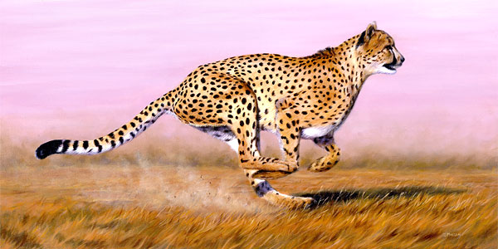
Science Media
Differences
Mutual objective:
and

Slide 25
Journalists, Editors, Media

Slide 26
Media:What‘ s in it for me?
Is it newsworthy?
Can be a black & white scenario?
One or mulitiple sources?
Story format
Selecting appropriate media
Interaction
Critical impact on the society
Controversion
Context
Notes:
„We need short, simple, effective story with impact and relevant speakers, who can present!“

Slide 27
Who decides is media?
Who writes?
How they write?
How they are prepared?
How much time do they have?
What readers want?

Slide 28
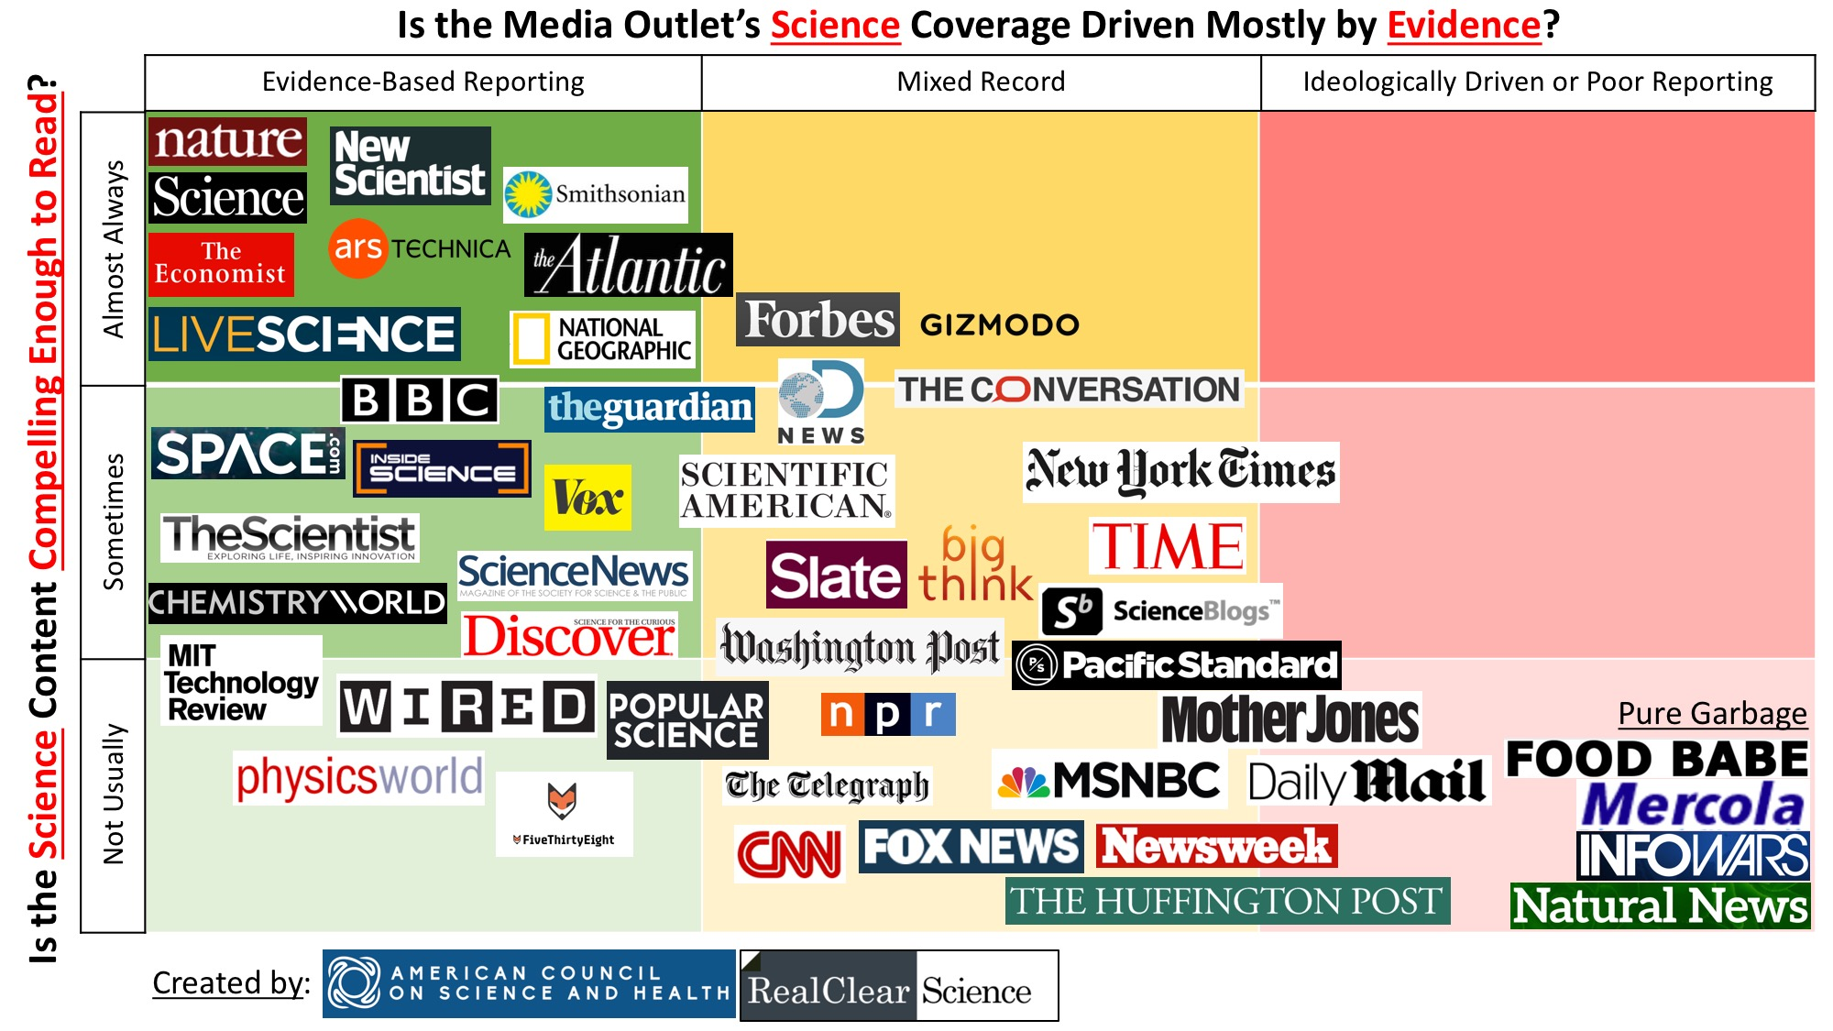

Slide 29
Where I work? What are my experiences with media?
icebraker

Slide 30
Structuring the Content:
Scientific environment vs lay environment
Contextualize your findings
( society, sport, ...)
Think about good parallels that make your story more relevant

Slide 31
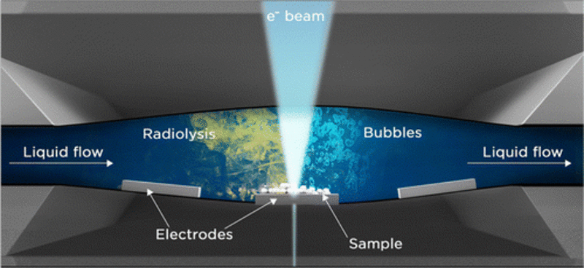
Story planning
You: What is my goal?
Media: What‘s the news?
Who is audience? / Who we are addressing?
What will be my message?
What are my advantages and why?
Where I have to be careful ( demage control)?
How I will present that to media?
Notes:
Načrtujem mojo zgodbo. Vzamem 5 minut miru- in podelim s svojimi kolegi.
Poskušam strukturirati

Slide 33
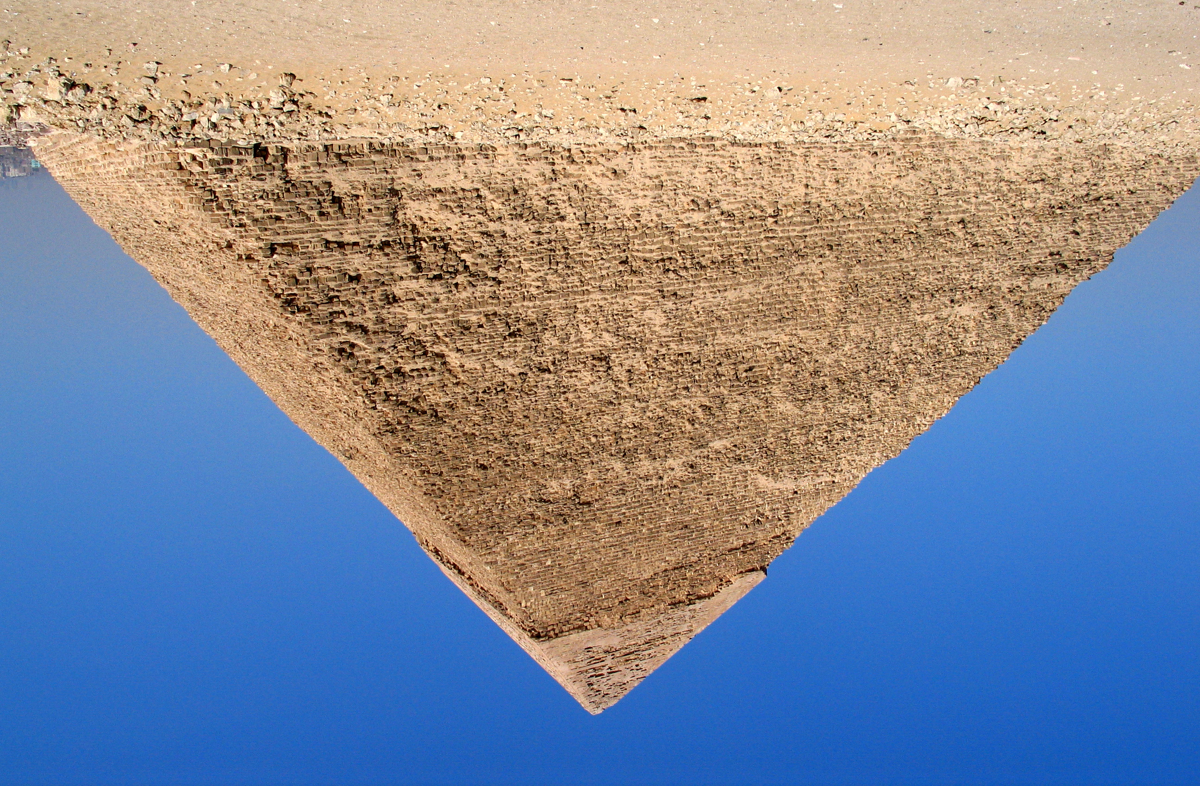
The lead: 30 most important words. The hook. –
The body: arguments, explanation, statements, information, photos,… –
The tail:extra info, related research, other sorces –
Notes:
INVERTED PYRAMID
Forget introduction - WHY this is relevant ?
FORGET EXPLAINING HIPOTESIS – Which social challenge /problem you are addressing?
Forget the conslusion – What is the benefit, what is the next step that should follow your research.

Slide 34
Which tools we will use? Which media outlet we will address?
Press conference? Event?
Presentation?
Shall we mix audiences?
When involve social networks?
Radio?
TV? = Digital?
Print?
Stakeholders mapping
Media list
Messages mapping
Outcome

Slide 35
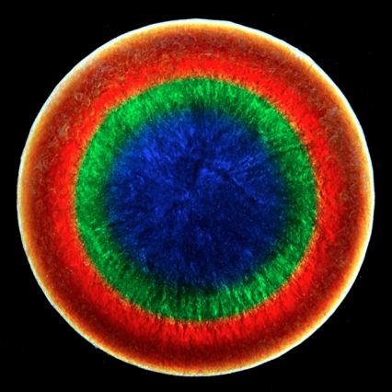
Visuals
Create understanding
Save time
Enhance attention
Help control timing and nervousness
Max: 6 lines or/ and 7 words per line
Notes:
Felice Frankell, MIT:
1 slide per 3 minutes. - 10 min presentation = 3 or 4 slides.

Slide 36
Getting into the right mood
Be friendly and warm.
Be ready to tell them something that they don‘t know, yet. Focus on your energy.
Think about you story.
How shall I open the presentation with:
Question?
Interesting facts?
Alerting curiosity?
Personal experinece?
Notes:
Audience may seem intimidating ...sometimes
Do not react on their behaviour. Turn to those who are listening to you.

Slide 37
How to prepare ? Can we do it alone?
CONTROL THE MESSAGES
TOOLS
Written statement (press, internet, social networks)
Audio statement (radio, internet, social networks)
Video reaction - photos and (live) broadcast (TV, internet, social networks)

Slide 38
Written statements. Print.
CONTEXT
CHECKLIST
Lead (Who/what? or When? Or quote Aha!)
The lead as appetizer
The lead is more informative than the title
As much W’s in a compact (not extensive) style
The sentences are short, the language simple
Inverted pyramide
Notes:
Piramida.
Razumljivost in relevantnost Kaj je rezultat? Kaj je bila motivacija? Kako/ kje bo to pomagalo družbi, da bo boljša ali bolj napredna? je

Slide 39
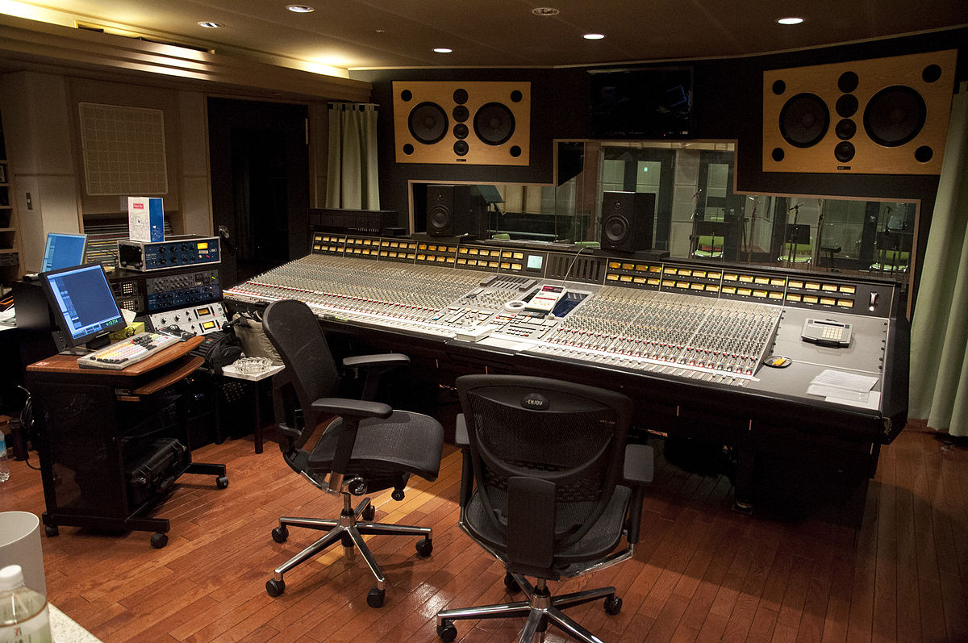
Radio. Podcasts.
TIME TO EXPLAIN
CHECKLIST
Relevance, importance, appeal
Extreme understandability - especially for one-time listeners
What is the most important comes first (inverted pyramid)
Lead (Who/what? or When? Or quote Aha!)
The lead as title
The importance of the announcement
As much W’s in a compact (not extensive) style
The sentences are short, the language simple

Slide 40
Voice
Key words
Voice range: volume ( hands up) vs. whisper
Pauses
Diaphragm
Silence
Voice modulation
When planning for a year, plant corn.
When planning for a decade, plant trees.
When planning for life, educate and train people.
Notes:
Najprej poudarki – besede
Volume – glasno, primi za diafragmo ob besedah,

Slide 41
TV, social media
VISUAL IS IMPORTANT
CHECKLIST
The ultimate significance of the first shot
The proportion between spoken text and images
The importance of the announcement
As much W’s in a compact (but lively) style
The sentences are short, the language simple
Notes:
Essece: picture and sound harmony
3 sec prnciple

Slide 42
Body Language
Breath – relax – smile
Body language or body noise
Moving? Or, finding i-spot
Do not lock arms
Eye contact
Contact with audience

Slide 43
Research disemination. Projects.
Corporate / institutional
Projects
EU
Local
Issue
Applied science

Slide 44
Project communication plan
Strategy Plan
Proactive
Operational
Usually engaged with partners
Task / objective oriented – disemination
Shorter term
Endorsment
Controlled
Defined audiences

Slide 45
Who is (your) target audience?
Lay public
Media
Peers
Regulators
Financers
International (EU, global)
Local community
Who should communicate?
Whos is audience? / Who we are addressing?
What is the news?
What will be my message?
What are my advatanes and why? Where I have to be careful ( demage control)?
How I will present that to media?

Slide 46
Best EU practises and some resources:
Notes:
Get over yourself!
It is about them, not you.

Slide 47
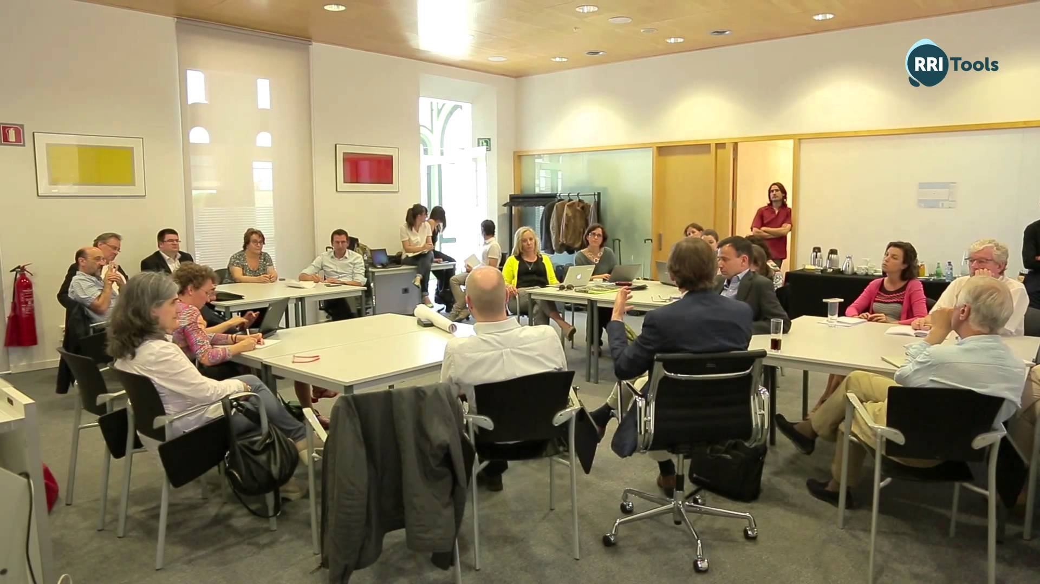
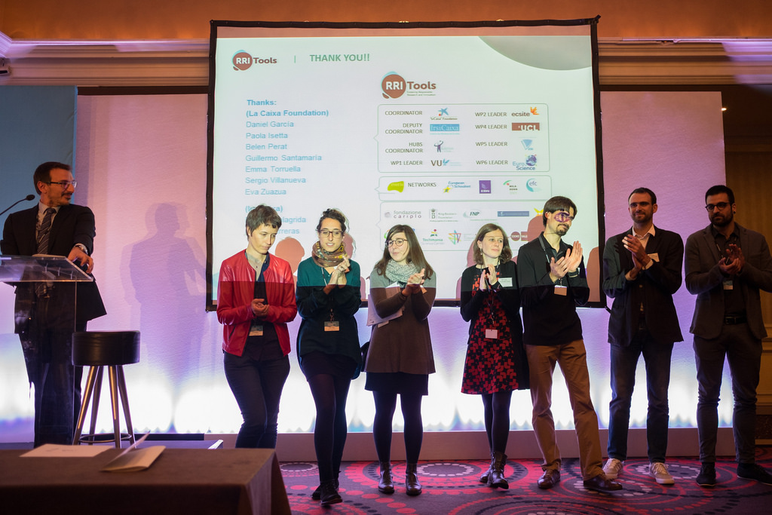
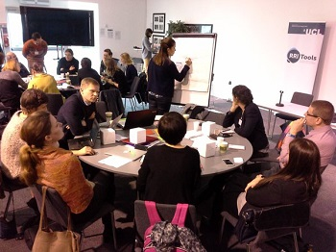
www.rri-tools.eu
Consortium of 26 organizations participating in the RRI Tools project
27 workshops involving 400 stakeholders in 24 countries across Europe
300+ resources in the Toolkit have been selected by the RRI Tools members with the collaboration of their partners in Europe

Slide 48
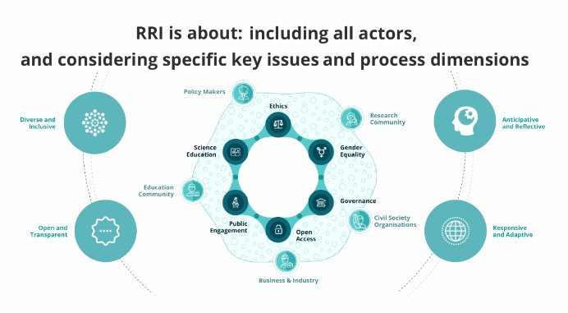

Slide 49
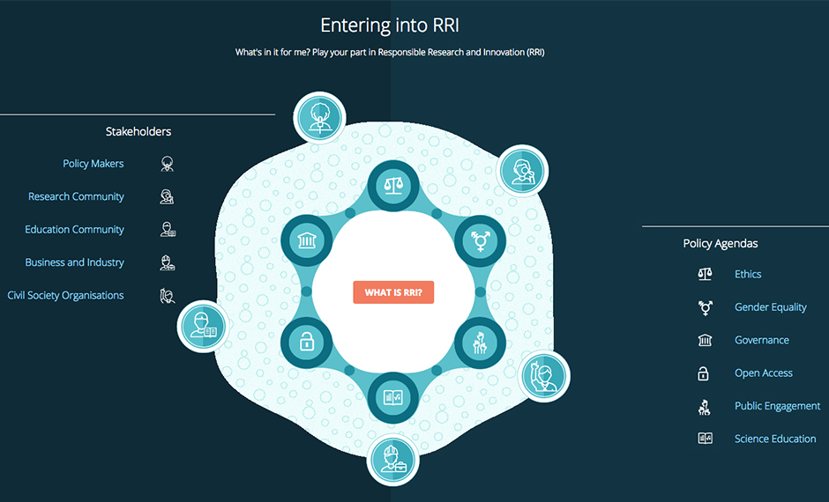
Notes:
Public engagement! !! USA, psevdo znanost, edukacija novinarjevc, obravnava deležnikov,

Slide 50
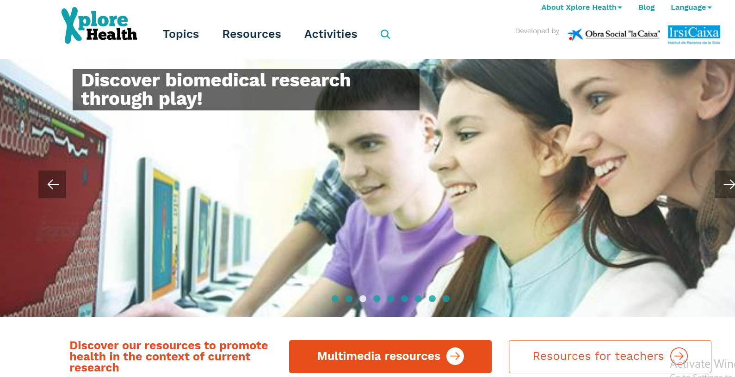

Slide 51
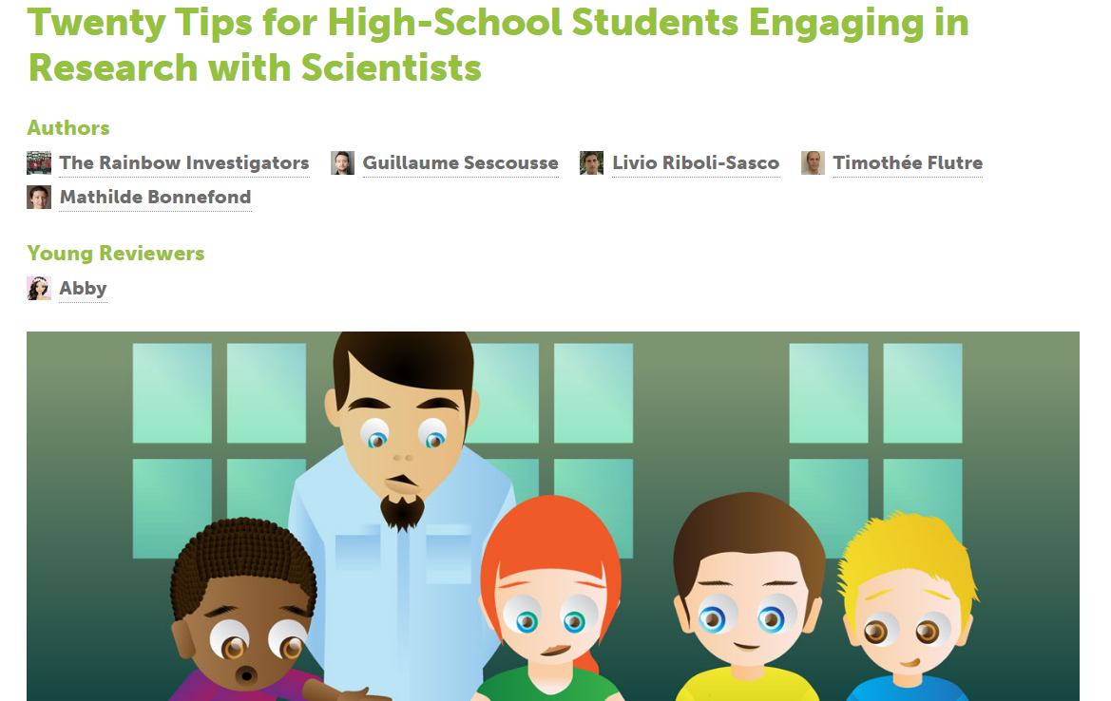

Slide 52
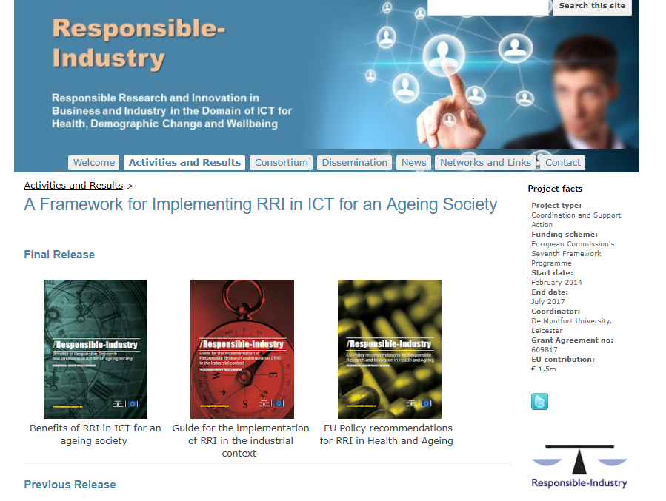

Slide 53
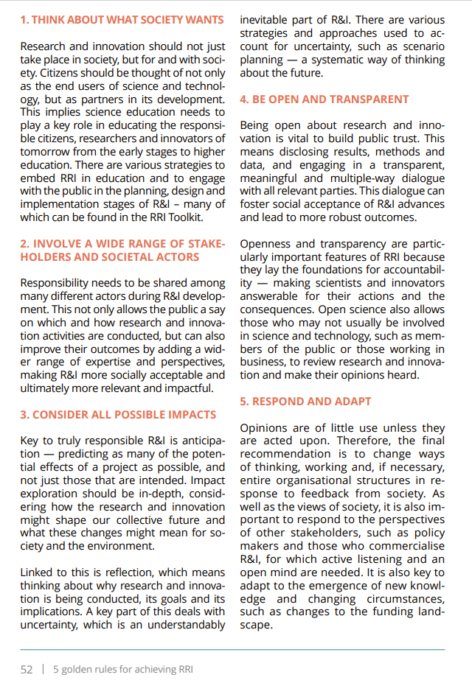

Slide 54
Plan it. Get help. It‘s all about skills!
Written stories | Video appearance | Radio / audio
How to create relevance How to create importance? Understanability of messages Visual help What more?

Slide 55
Corporate / Institutional
Projects
Issue
Ad hoc
Crisis
Awards

Slide 56
Issue management
Crisis
Proactive / Reactive
Short term
One issue, one objective

Slide 57
Conclusion...

Slide 58
Take aways: - there is no „copy – paste“ to use - be creative and find a relevant context - it is about the impact and reputation - get the skills (pressure your RI) - be confident: you create better society
Does this resonate with my RI?

Slide 59
Thank you
jadranka@kontekst-svetovanje.si

