Slide 1
SESSION 1 POST OPEN ACCESS TRANSITION
jadranka Stojanovski, University of Zadar / Ruđer Bošković institute

Slide 2
If where and how much you publish is a matter of how much you can afford to pay, how should this be reflected in responsible research evaluation?
My short answer would be: No, it is not possible to have responsible resesarch evaluation in the present system, where we evaluate:
for rankings, competition
(formal) citations from limited citation datasets
according to not-transparent and not-adequate metric indicators
based on quantitative indicators exclusively

Slide 3
Need for changes in the system
promote intedisciplinary research, diversity between disciplines
research integrity
open science
evaluate other types of impact (societal, economic, academic...)
stimulate quality of research and good research practices
value diversity in research activities, outputs...
if quanititative: combination of different indicators, only at broad aggregation level (not individual), in line with objective of evaluation (what we want to achieve? what is important?)
Notes:
promote intedisciplinary research, sensitive about diversity between disciplines
research integrity
open science
evaluate other types of impact (societal, economic, academic...)
stimulate quality of research and good research practices
value diversity in research activities, outputs...
if quanititative: combination of different indicators, only at broad aggregation level (not individual), in line with objective of evaluation (what we want to achieve? what is important?)

Slide 4
Widening qualitative part of the research evaluation
Open Peer Review, with community contribution, more holistic approach
post-publication peer review
group of expert-evaluators evaluating achievements, not the list of outputs
evaluation which allows different kinds of careers, different activities
fostering collaboration
lowering the competition!
making researchers proud for their achievements

Slide 5
ERAC Guideline Paper Research evaluation in a context of Open Science and gender equality
Foster the diversity of open research ecosystems
Promote inclusiveness and collective involvement in the design of Open Science and research evaluation policies;
Encourage a responsible attitude in research evaluation;
Foster transparency in research evaluation and trustworthiness in the added value of Open Science and gender equality;
Provide the right incentives through evaluation -
Create a virtuous circle between training and evaluation.
Notes:
Foster the diversity of open research ecosystems - – whole range of openly accessible research outputs and processes
Promote inclusiveness and collective involvement in the design of Open Science and research evaluation policies - including the perspectives from the different stakeholders as well as from researchers from different disciplinary backgrounds, gender and at different stages of their career
Encourage a responsible attitude in research evaluation;
Foster transparency in research evaluation and trustworthiness in the added value of Open Science and gender equality;
Provide the right incentives through evaluation - The full diversity of Open Science practices should be rewarded, whether they relate to research outputs or processes
Create a virtuous circle between training and evaluation - As a general principle, researchers should only be assessed in regard to skills and practices for which they have been duly trained or are offered the opportunity to get trained in. Any change in research evaluation - including in regard to Open Science and gender equality - should therefore be accompanied by related reforms in the researchers’ and evaluators’ training schemes.

Slide 6
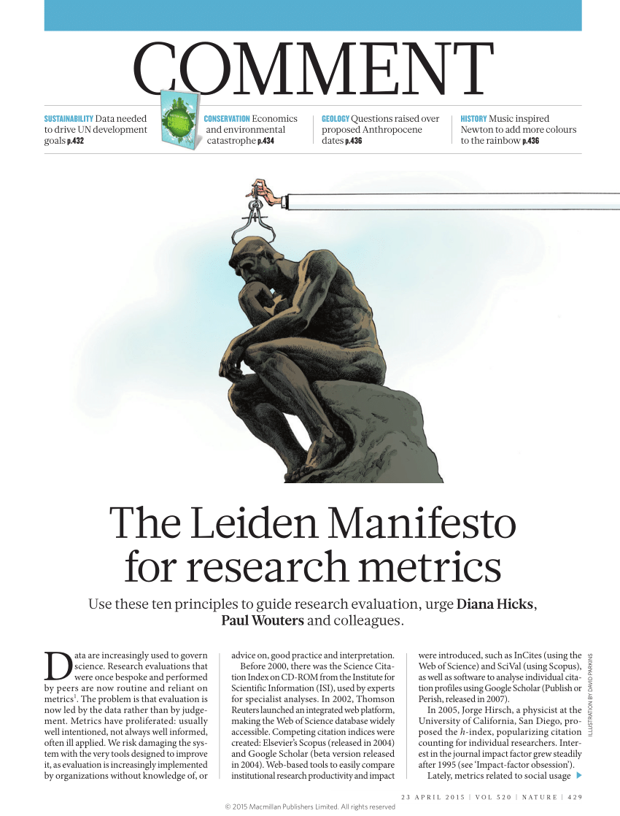

Slide 7
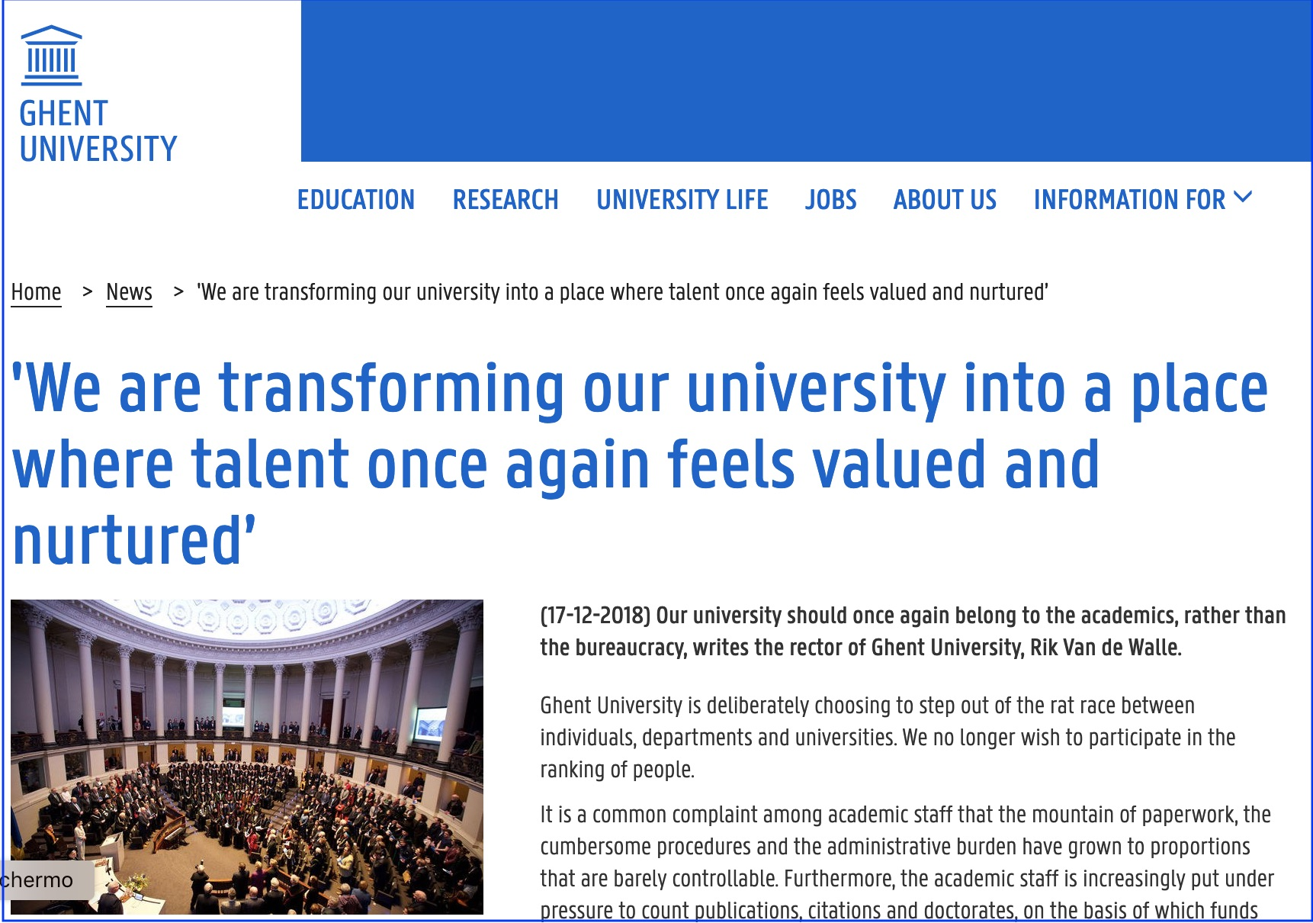

Slide 8
University of Gent
Personal growth and career guidance
Self-reflection & dialogue with HR committee
Administrative simplification and lower evaluation rhythm
Aim: stimulate more differentiated and complementary careers; allow more time for research, teaching and other academic activities; lower the competition (those who perform well will be promoted)
Nele Bracke, 2020

Slide 9
