Slide 1
Open research data How to make it work with
17/09/2021
Krzysztof Szymański

Slide 2
The need to track and report on research data output
Institutions want to:
Oversee the management of institutional policies
Safeguard compliance with funder mandates
Maintain an overview of where data is deposited
Showcase research data output
Challenge 1
The majority of public data is deposited outside the institutional data repository
Challenge 2
Tracking data outside the institutional data repository is a time-consuming process
Reference: https://blog.research-plus.library.manchester.ac.uk/2019/02/15/from-couch-to-almost-5k-raising-research-data-visibility-at-the-university-of-manchester/

Slide 3
Majority of public research data is hosted outside your institution
~90%
of the public research data is hosted on external general subject or domain repositories
“There is a broad spectrum of RDM practices used by our researchers, often due to a multitude of data types and a range of discipline-specific practices.
We see the libraries role as one that is focused on tracking archival practices of raw research data sets, assigning appropriate ontologies/metadata, providing appropriate linking and checking that the data has been stored in a secure location.”
Dr. Andrew White Director of Library Information Services at Rensselaer Polytechnic Institute
~10% of public research data is hosted on institutional repositories
Source: internal analysis

Slide 4
It’s a manual time-consuming process
A lack of automated RDM tracking tools makes it difficult for institutions to find where researchers are hosting their public data.
One of our development partners had to allocate two full-time employees to spend six months manually searching for datasets for a random selection of 886 articles published by researchers in their institution between 2015-2017.

Slide 5
Your researchers have access to thousands of repositories
It’s difficult for you to have full visibility of these repositories, meaning that it's unlikely that you’ll be able to actively monitor all the repositories your researchers are choosing to use.
Research data repositories | Number of datasets
Zenodo | 2093825
Figshare USGS Mineral Resources | 1139029 995208
Cambridge Structural Database | 932033
arXiv | 555161
Global Biodiversity Information Facility | 1075251
Our solution:
Provides you with visibility for the entire research data output of your institution
Integrates 28+ million research data records from 2000+ generalist and domain specific repositories
Reference: https://datascience.codata.org/articles/10.5334/dsj-2017-042/

Slide 6
Our solution is better than open source
[University of Barcelona]
73 results found using open source DataCite API
6230 results found through Mendeley Data Monitor

Slide 7
How does our solution work?
2000+ generalist and domain specific repositories (incl. DataCite)
28+ mln research data records
Mendeley Data Monitor corpus
Clean up
Enrichment
Your Institutional Data Repository
Step 1
We collect datasets that researchers have published in repositories outside your institutional data repository
Step 2
We eliminate duplicates, e.g. different versions of the same dataset
Step 3
We add author and institutional affiliation to datasets
Notes:
Also see the Backup with the blue text

Slide 8
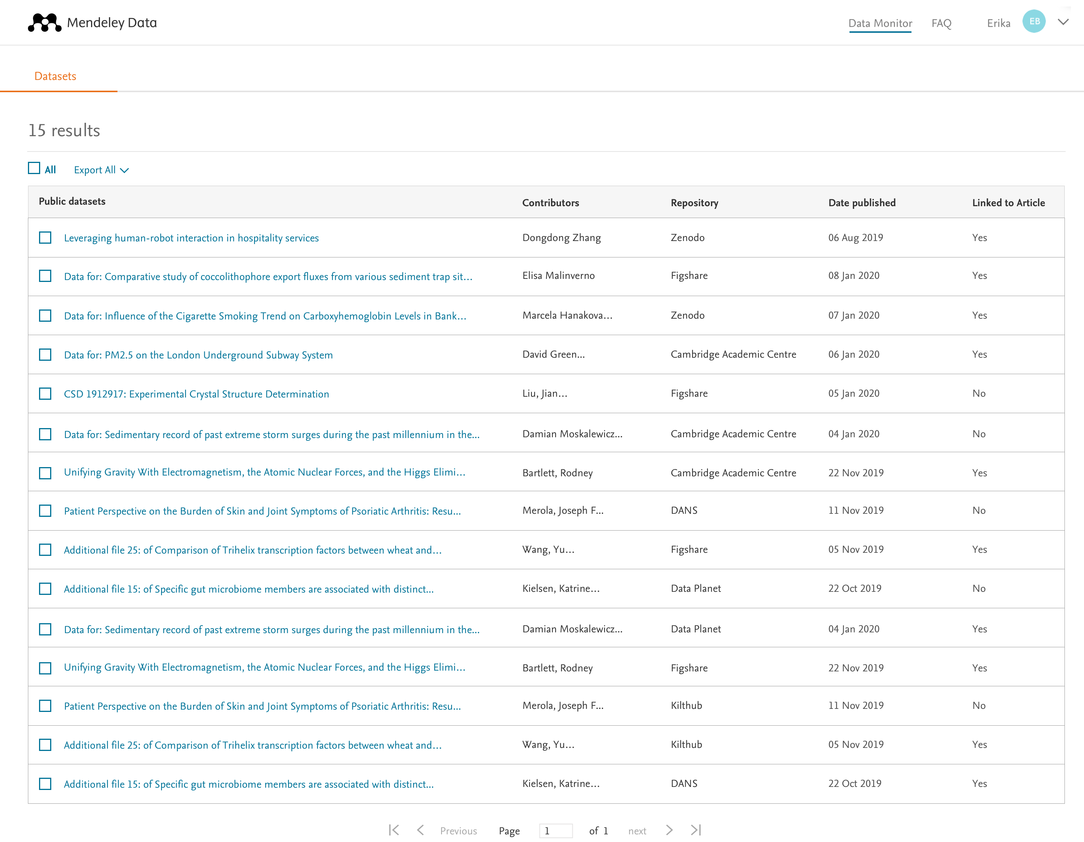
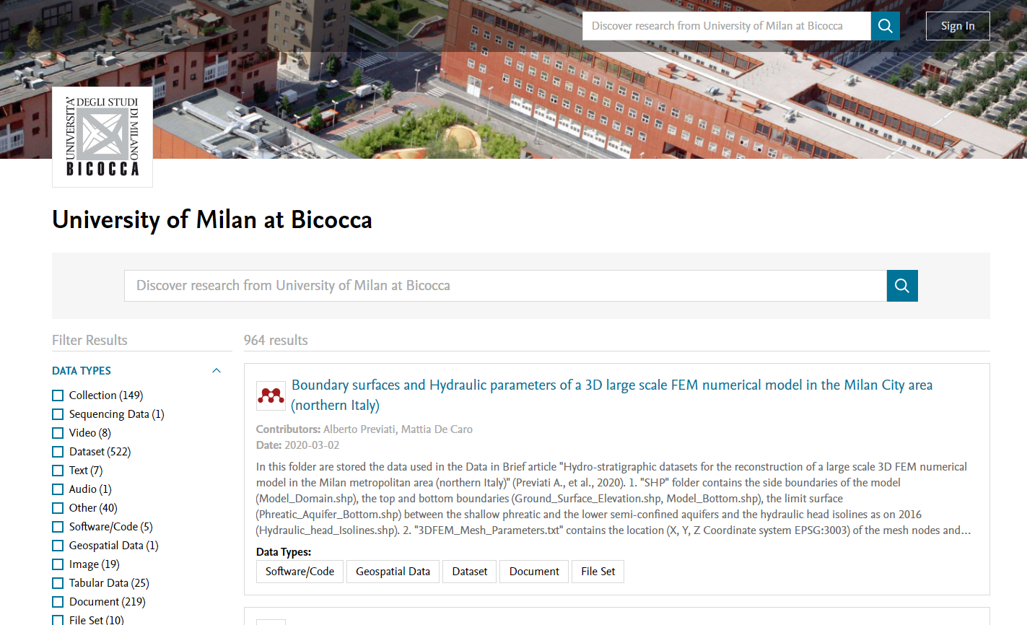
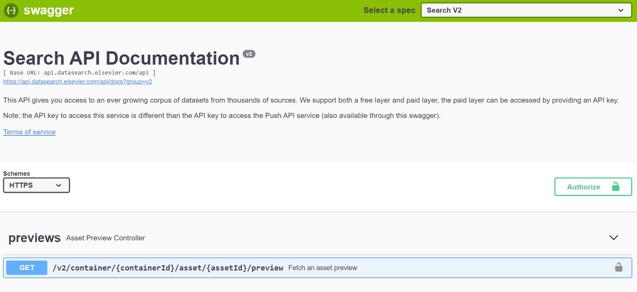
Mendeley Data Monitor: putting you in the RDM driving seat
Organize, curate and report on public research data
Showcase public research datasets
Integrate with your CRIS through an API
Perform advanced data search queries

Slide 9
An-end to-end RDM solution for institutions
A comprehensive data search engine including 28+ million datasets indexed from 2000s of data repositories
A repository specialized for research data, to store and share datasets following the FAIR data principles
A collaborative team workspace where researchers can share project data, integrate external data sources securely and prepare datasets for publication
The Mendeley Data platform gives you full control to successfully drive forward your institutional Research Data Management (RDM) policy
A tool to track datasets published by researchers both within and outside the institution, to facilitate compliance with funders' mandates and enable reporting and showcasing

Slide 10
Krzysztof Szymański
k.szymanski@elsevier.com

