Slide 1
Digital Reference Management: Tools and Techniques
Tomislav Ivanjko, PhD, Assistant Professor University of Zagreb Faculty of Humanities and Social Sciences Department of Information and Communication Sciences
PUBMET2021 - The 8th Conference on Scholarly Communication and Publishing in the Context of Open Science

Slide 2
Workshop outline
Part 1 - Introduction to digital reference management (15 min)
Discussing best practices
Choosing the right software
Part 2 - Practical demonstration with Zotero (1h 15min)
The Basics – Installation, interface and preferences
Collecting sources - Getting documents into your library
Organizing sources - Organizing your library and taking notes
Citing sources - Generating bibliographies, citations, and reports
Managing your data - Syncing, collaboration, and backup
Getting the most out of Zotero – Plugins, tips and tricks
Part 3 - Questions and comments (30 min)
PUBMET2021 - The 8th Conference on Scholarly Communication and Publishing in the Context of Open Science

Slide 3
Digital reference management
Reference management software, citation management software, or bibliographic management software is software for scholars and authors to use for gathering and utilising references
Digital reference management tools can help in the process
gathering documents,
organizing selected sources
creating a bibliography
and much more..
Latest Wikipedia entry lists 30 different reference management tools
Zotero, Mendeley, RefWorks, EndNote, Bibsonomy, Paperpile,….
PUBMET2021 - The 8th Conference on Scholarly Communication and Publishing in the Context of Open Science

Slide 4
Key questions to select the right reference management software
Ease of Use / Usability
Do I like the interface?
Is it intuitive to me?
Do I easily find the functions I'm looking for?
Operating system
Which software can I use with my operating system (Linux, Mac, Windows)?
Which software offers an online version?
What external programs should my reference management software support (e.g. word processor)
Which software offers a mobile version / app?
Reference Management Software Comparison - 8th Update (June 2020)
PUBMET2021 - The 8th Conference on Scholarly Communication and Publishing in the Context of Open Science

Slide 5
Key questions to select the right reference management software
Support
Are there any training courses for beginners?
Are there any materials for self training (e.g. videos, manuals)?
Is there any support if I need help (library, company, IT hotline, forums etc
Costs
Does the software cost anything?
Are there potentially additional costs (e.g. after leaving institution, need for more storage space)?
Where do I usually work?
Do I use always the same computer or do I switch sometimes?
Do I have permission to install software on the computer I use?
What reference management software do my colleagues / collaborators use
Reference Management Software Comparison - 8th Update (June 2020)
PUBMET2021 - The 8th Conference on Scholarly Communication and Publishing in the Context of Open Science

Slide 6
Key questions to select the right reference management software
What features should my reference management software offer?
Catalogue and database search from within the program?
Indexing and structuring of content?
Searching for full texts?
PDF editing?
Creating reference lists?
Managing citations?
Online access?
Sharing and / or jointly editing references?
Reference Management Software Comparison - 8th Update (June 2020)
PUBMET2021 - The 8th Conference on Scholarly Communication and Publishing in the Context of Open Science

Slide 7
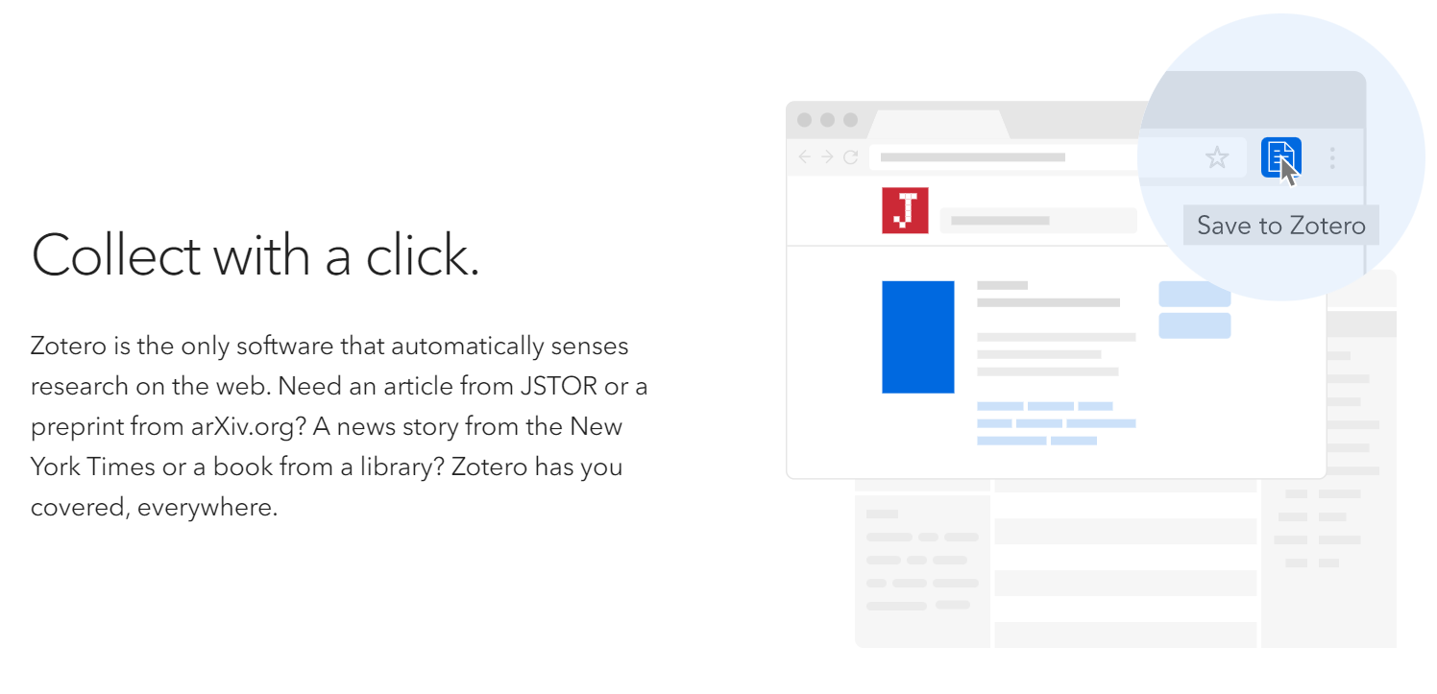
Why Zotero?
https://www.zotero.org/
PUBMET2021 - The 8th Conference on Scholarly Communication and Publishing in the Context of Open Science

Slide 8
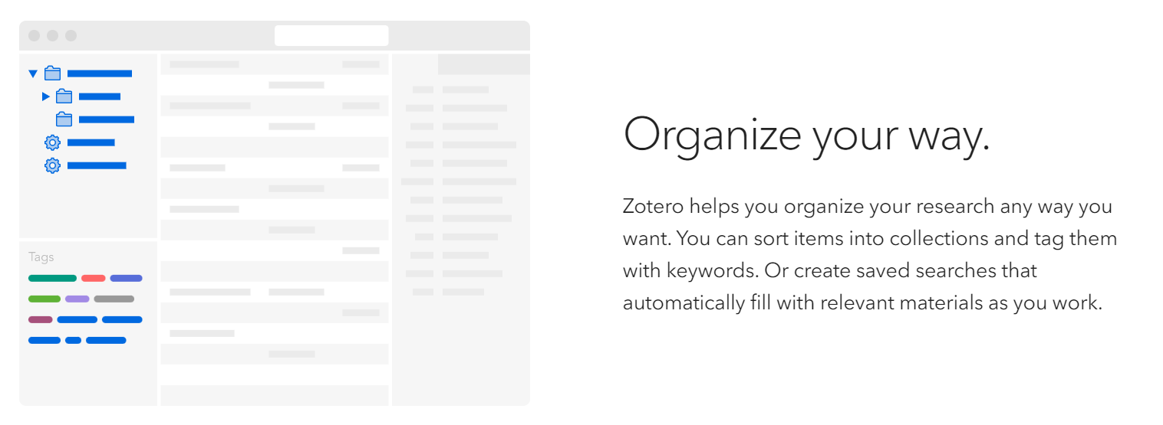
Why Zotero?
https://www.zotero.org/
PUBMET2021 - The 8th Conference on Scholarly Communication and Publishing in the Context of Open Science

Slide 9
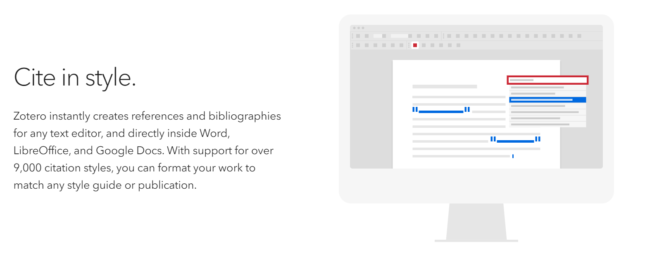
Why Zotero?
https://www.zotero.org/
PUBMET2021 - The 8th Conference on Scholarly Communication and Publishing in the Context of Open Science

Slide 10
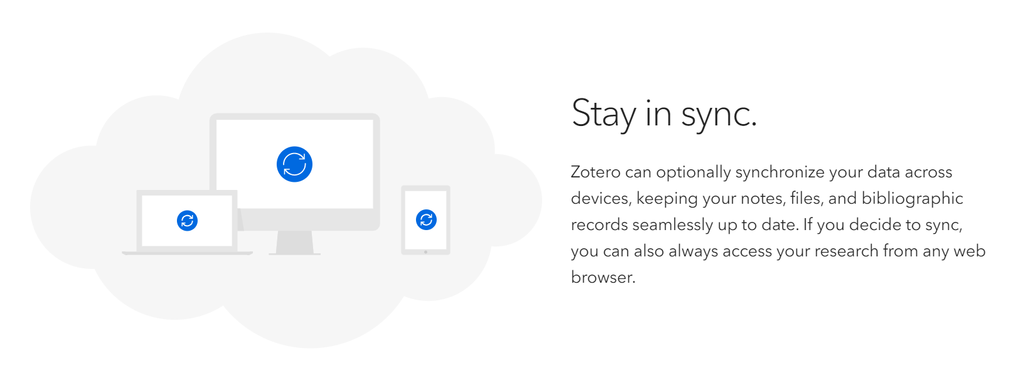
Why Zotero?
https://www.zotero.org/
PUBMET2021 - The 8th Conference on Scholarly Communication and Publishing in the Context of Open Science

Slide 11
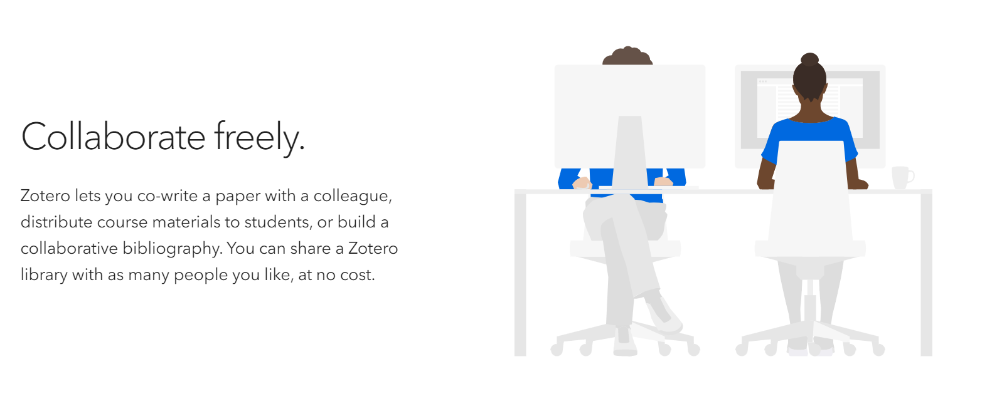
Why Zotero?
https://www.zotero.org/
PUBMET2021 - The 8th Conference on Scholarly Communication and Publishing in the Context of Open Science

Slide 12
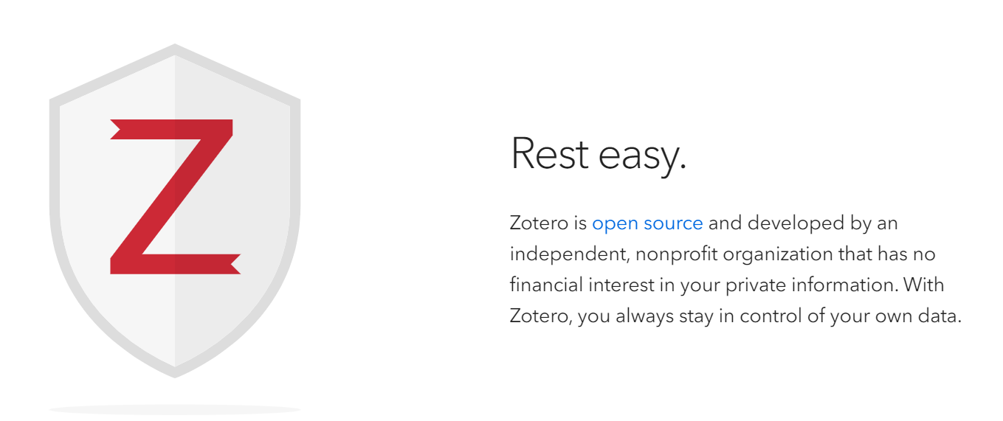
Why Zotero?
https://www.zotero.org/
PUBMET2021 - The 8th Conference on Scholarly Communication and Publishing in the Context of Open Science

Slide 13
Demonstration
PUBMET2021 - The 8th Conference on Scholarly Communication and Publishing in the Context of Open Science

