Slide 1
Words Can Kill or Words Can Heal - The Choice is Yours
Vladimira Šimić, editor and journalist, Cyrano komunikacije
Croatia

Slide 2
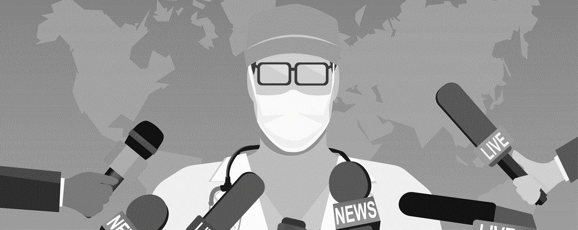
Journalists are an important link in the chain of scholar communication.

Slide 3
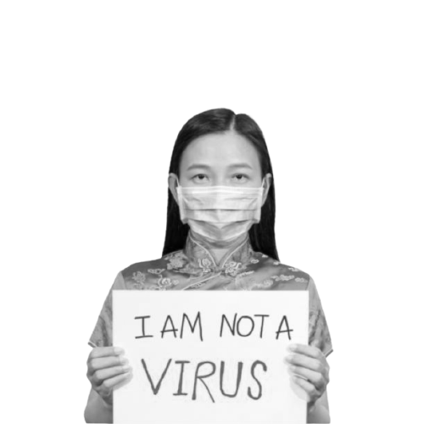
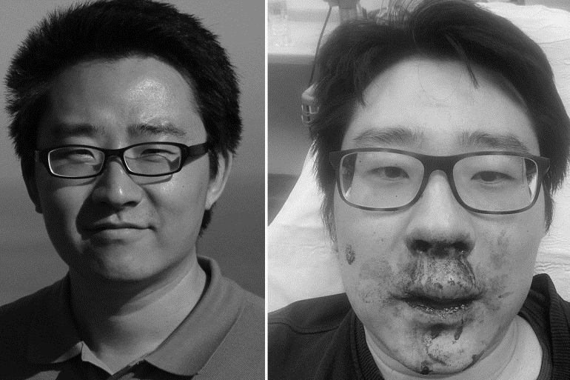
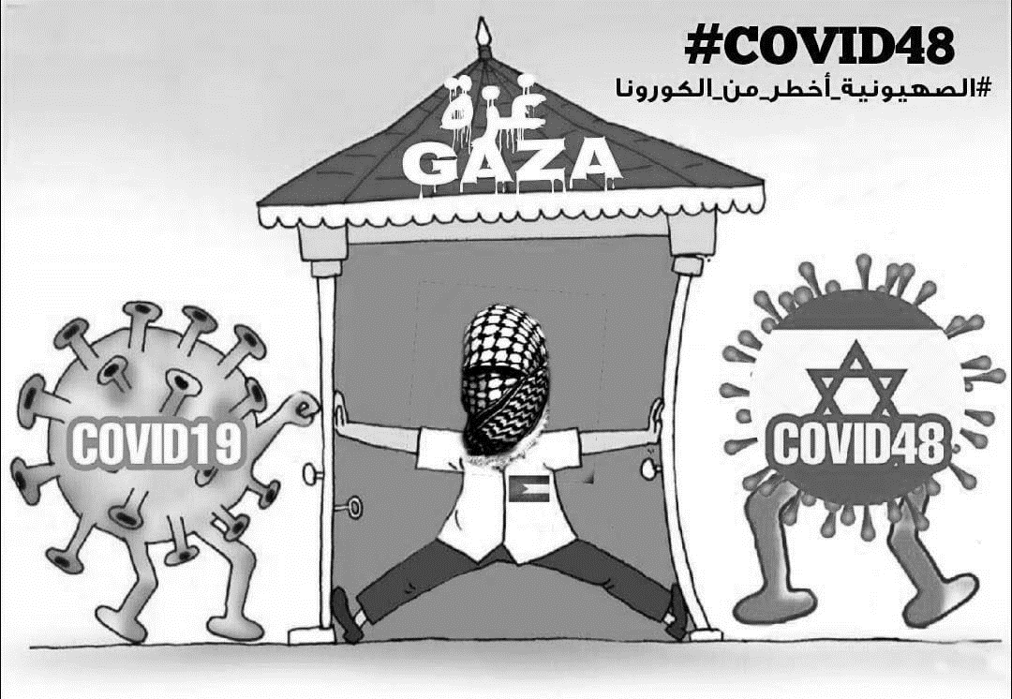
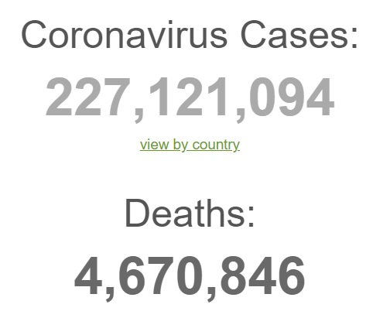
Pandemic and infodemic - both are dangerous and deadly
in its own way.

Slide 4
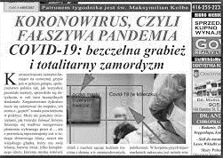
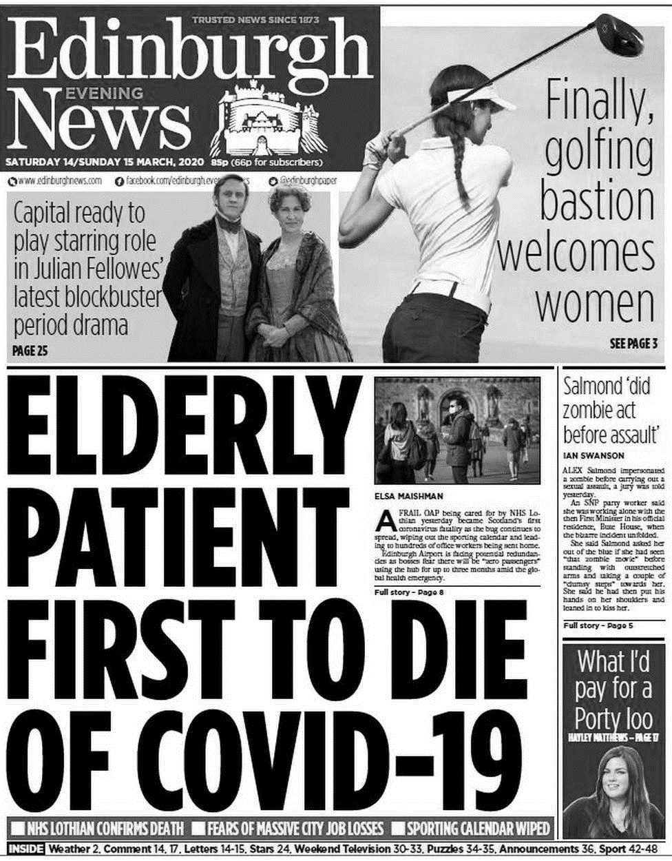
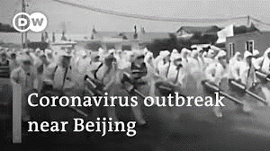
COVID-19: an unprecedented news story!

Slide 5
As all challenges in our lives, this pandemic is giving us the opportunity to become stronger, to grow, to develop competencies and - above all – to learn, to educate ourselves.
An opportunity we should not miss!

Slide 6
People must understand that their health, as well as their life - especially in this situation (!) - depends on health literacy. Basic health literacy of the population is precondition of any successful public health action.
Importance of health literacy

Slide 7
Messages: Only facts. Messages should be as simple and as understandable as possible.
Use arguments, not insults. „Attack” ideas, not people, avoid aggression. Be careful with humor - avoid cynicism and sarcasm.
Think carefully before you speak with a journalist: you are responsible for each word.
Synergistic effect: There should be more of organized activities on social networks like UN’s project HALO.
Contribute to scientific/health literacy. Scientists should share basic knowledge from their field whenever and wherever they can.
How should scientists communicate with medias/public?

Slide 8
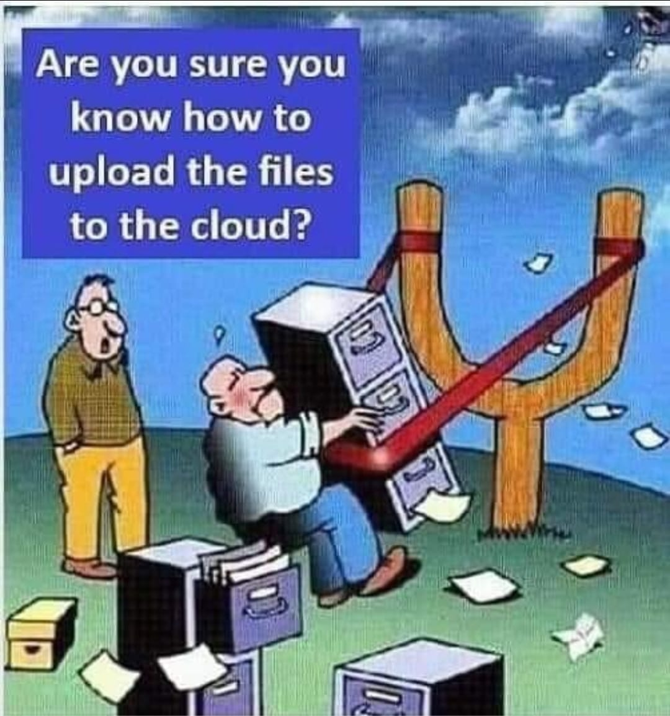
I hope this all will contribute to a better understanding of science. :)
Thank you!

